Slide 1
Euglycemic diabetic ketoacidosis induced by sodium-glucose cotransporter 2 inhibitor in the setting of prolonged fasting:
Presenter: Naimeh Soltani
Supervisor: Master Rasouli

Slide 2
Types of diabetes

Slide 5
The clinical manifestation of type 1 diabetes is
polydipsia
, polyuria,
weight loss,
Polyphagia
, blurred vision,
and ketoacidosis in 25% of cases.

Slide 6
DKA
Seen in type 1.
Its three clinical features are: - Hyperglycemia
Dehydration and loss of electrolytes acidosis
Etiology:
Reducing the amount of insulin or forgetting to take it illness or disease Undiagnosed or untreated disease

Slide 7
DKA
Clinical protests :
Polyuria,
polydipsia,
blurred vision,
weakness and headache Postural
hypotension Occurrence of gastrointestinal
complications due to sympathetic stimulation caused by ketoacidosis
The smell of acetone from the patient's mouth and the breath of Cosmol
Decreased level of consciousness to coma

Slide 8
Diagnostic findings:
Blood sugar between 80-300 mg/dL
Presence of acidosis with bicarbonate less than 15 ml equivalent and pH less than 3.7
An increase or decrease in Na (the cation is intracellular. In DKA, potassium leaves the cell and causes hyperkalemia. In this case, fluid therapy, insulin therapy, and bicarbonate injection are needed to reduce potassium.)
Increase in BUN and Cr, Hb and Htc due to dehydration

Slide 10
Type 2 diabetes is a multifactorial disease and the following two factors are involved in its development:
1- Genetic aptitude (history of diabetes in first degree family members i.e. father, mother, brother or sister)
2- Environmental factors that include: Physical inactivity Improper nutrition Obesity and high BMI and fat distribution (in case of normal BMI) around the waist and hips
Causes of type 2 diabetes

Slide 11
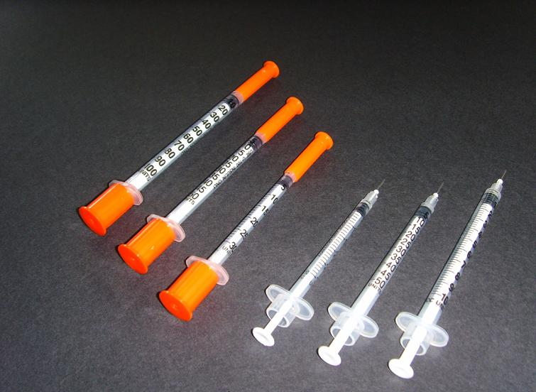
Drug treatment of diabetes

Slide 12
Oral medications
1-Sulfonylureas (glybenclamide, glyburide, tolazamide, tolbutamide)
2- Biguanidines (in Iran, there is only metformin.)
3- alpha glycosidase inhibitors (acarbose

Slide 13
Diagnosis of diabetes
Two servings of fasting venous blood plasma sugar are equal or be more than 126 mg/dl

Slide 14
Methods of preventing type 2 diabetes
Methods of preventing type 2 diabetes:
1) Changing eating habits and reducing consumption of saturated fats and reducing caloric intake
2) Increasing physical activity
3) Quit smoking
4) Weight loss
5) Reducing daily stress
6) People over 30 should check their fasting blood sugar once every three years.

