Slide 1
Case Report
Rare Complications of Acute Appendicitis
Presenter : mobin Ghaderi
Master: mr.rasoli

Slide 2
INTRODUCTION
Appendicitis is a common disease with a lifetime incidence of 8.6% of men and 6.4% of women.
nausea, anorexia
right lower quadrant tenderness
, including perforation, abscess formation, and peritonitis

Slide 3
CASE REPORT
A 37-year-old male
emergency department (ED
12 days of fever
vague abdominal pain
an “L” shape from the right upper quadrant
(PCP) and (UC).

Slide 4
He worked as a personal trainer
about one week due to profound fatigue
fever was cyclical
acetaminophen and ibuprofen

Slide 5
myalgias.
elevated liver function tests. At the PCP's office after three days of fever he had no leukocytosis
no guarding
on abdominal exam or abdominal tenderness, and negative testing for Lyme disease, anaplasma, babesia, ehrlichiosis, and influenza.

Slide 6
having six days of fevers with a headache.
No rash
no guarding ,
arthralgias.
Lab testingrevealed no leukocytosis
parasites negative.
elevation of his ALT and ALP

Slide 7
vital signs
blood pressure : 149/80 millimeters mercury,
a heart rate of 107 beats per minute
a temperature of 99.2°F,
a respiratory rate of 16
Spo2 100%
Upon history, cyclical fevers 12 days
weakness and abdominal discomfort
, no signs of meningismus,
non-tender abdomen.

Slide 8
Laboratory values showed
a drop in his hemoglobin from 13.3 to 11.0 (mg/dL) 11.2-15.7
a mild leukocytosis of 12,000 (4.0-10.0K/uL) with 84% neutrophils (34-71%)
an elevated aspartate
AST 66 (0-40 IU/L)
ALP 275 (40-130 IU/L)
urinalysis no urinary infection.

Slide 9
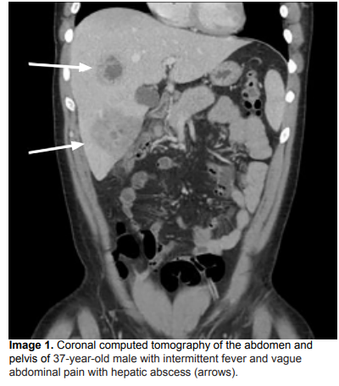
Laboratory values showed
A chest radiograph was negative for signs of pneumonia, after which a (CT) of the abdomen and pelvis with (IV) contrast was showed multiple liver abscesses

Slide 10
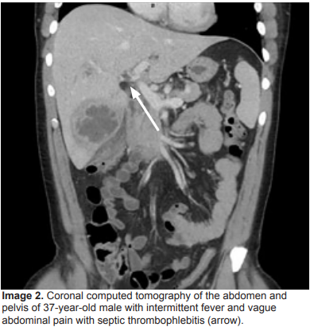
Laboratory values showed
Septic thrombophlebitis of the portal system in hepatic segments six and eight

Slide 11
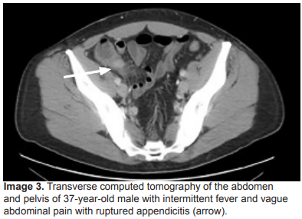
Laboratory values showed
evidence of ruptured appendicitis

Slide 12
broad spectrum IV antibiotics
the first 48 hours had IR-guided abscess drainage.
penicillin sensitive. ultimately
interval appendectomy.

Slide 13
DISCUSSION
Appendicitis common affecting
8.6% males and 6.7% females,
most commonly 10-18 years.
More than 250,000 appendectomies
highprevalence of this condition, the complications extremely uncommon.
1950s, cases of septic thrombophlebitis occurred 0.4% of cases of appendicitis

Slide 14
DISCUSSION
Septic phlebitis and hepatic abscesses
fever, mild peritoneal findings, nausea, vomiting, or abdominal distention, normal liver and blood
CT of the abdomen and pelvis due to fever of unknown origin fever and pe abdominal pain and anorexia, despite his abdominal exam. The initial expectation as lymphoma,
B symptoms ( fevers, night sweats, weight loss) lack of a tender abdomen."
Notes:
. فلبیت سپتیک و آبسه های کبدی می توانند یافته های بالینی غیراختصاصی مانند تب، یافته های صفاقی خفیف، تهوع، استفراغ یا اتساع شکم داشته باشند و اغلب با آزمایش های عملکرد طبیعی کبد و کشت خون همراه می شوند. به دلیل تب مداوم بیمار با منشأ ناشناخته و شکایت مداوم از درد شکم و بی اشتهایی، علیرغم معاینه خوش خیم شکم، سی تی شکم و لگن را دریافت کردیم. انتظار اولیه این بود که بیمار با توجه به علائم B (یعنی تب، تعریق شبانه و کاهش وزن) و نداشتن شکم حساس، ممکن است یک بدخیمی مانند لنفوم داشته باشد.

Slide 15
DISCUSSION
this case shows that CT imaging can in abdominal pain
non-tender abdomen with fevers and is workup.
Even classic right lower quadrant tenderness is only shown to be sensitive between 50-94% of the time
. If appropriate imaging is not performed, cases of appendicitis can progress to develop complications involving multiple organs as well as septic thrombi

Slide 16
CONCLUSION
a rare complication of a common disease
The patient with nonspecific laboratory findings.
His only lab abnormalities were AST and ALP and neutrophils.
His vs tachycardia and fever unknown origin led the clinical team to believe there was underlying pathology that needed additional workup despite his overall well appearance.

Slide 17
Thank you

