Slide 1
DVT
محمد امین باشتنی استاد راهنما: استاد غلامی

Slide 2
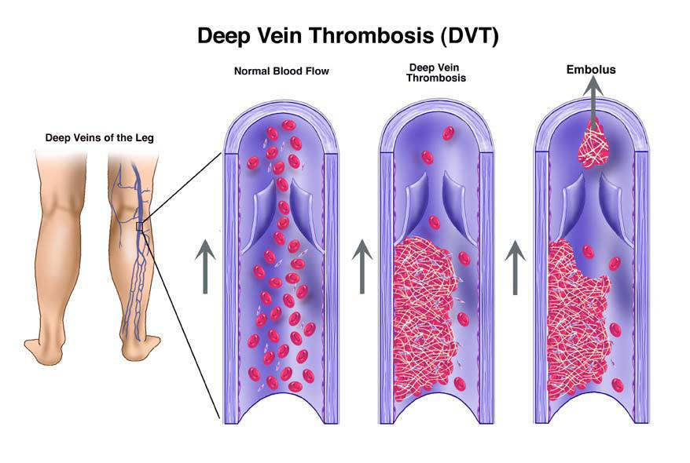
What is Deep Vein Thrombosis (DVT)?
DVT occurs when a blood clot or thrombus, develops in the large veins of the legs or pelvic area. A clot that forms in the large, deep veins is more likely to break free and travel through the vein. It is then called an embolus. When an embolus travels from the legs or pelvic areas and lodges in a lung artery, the condition is known as a “pulmonary embolism,” or PE, a potentially fatal condition if not immediately diagnosed and treated.

Slide 3
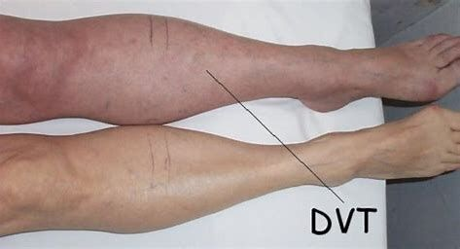
Most common Signs and Symptoms of DVT
Sudden swelling of one limb
Pain or tenderness
Skin that is warm to the touch
Fullness of the veins just beneath the skin
Change in color (blue, red or very pale)

Slide 4
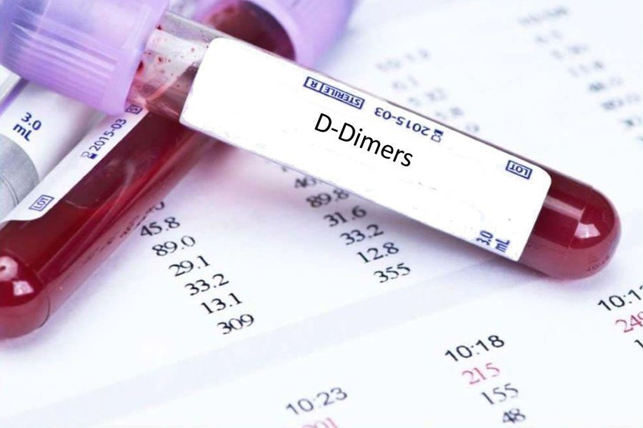
Diagnosis
D-dimer
Venography
CT Scan

Slide 5
Causes
DVT is generally caused by a combination of two or three underlying conditions:
Slow or sluggish blood flow through a deep vein
Tendency for a person’s blood to clot quickly
Irritation, inflammation or injury to the inner lining of the vein

Slide 7
Treatment
Walt Disney

Slide 8
Some Tips to Avoid DVT
Do not sit for long periods of time
Elevate legs if you are sitting for moderate periods of time
If you are on an airplane for more than four hours-get up and walk in the aisles, pump your feet up and down
If you are flying, drink plenty of non-alcoholic beverages
Drink six glasses of water a day
If you have varicose veins, wear support hose (especially if pregnant)
Do not wear constricting garments around the legs or waist (elasticbands or garters)

Slide 9
Thank you

