Slide 1
change position
Persent by : Yasman sadat Salehi
Supervisor :Mrs.Heirati

Slide 2
Goals of positioning:
Improving chest expansion and lung ventilation.
Providing more comfort to patient.
The possibility of doing some daily activities.
Help maintain skin health.

Slide 3
01
02
Guiedlines for patient positioning:
03
04
Explain the procedure.
Encourage the patient to assist as much as possible.
Get adequate help.
Use mechanical aids.
05
06
Frequent position changes.
Avoid friction and shearing.

Slide 4
Place yourself near the patient.
Proper body mechanics for your safety and your patients safety:
Avoid twisting your back , neck and pelvis by keeping them aligned.
Bend your knees and keep your feet apart.
Use your arms and legs and not your back
.
Tighten your abs and gluteal muscels to prepare for the move . The person with the nurses efforts and begins counting to 3.

Slide 5
common patient positions :

Slide 6
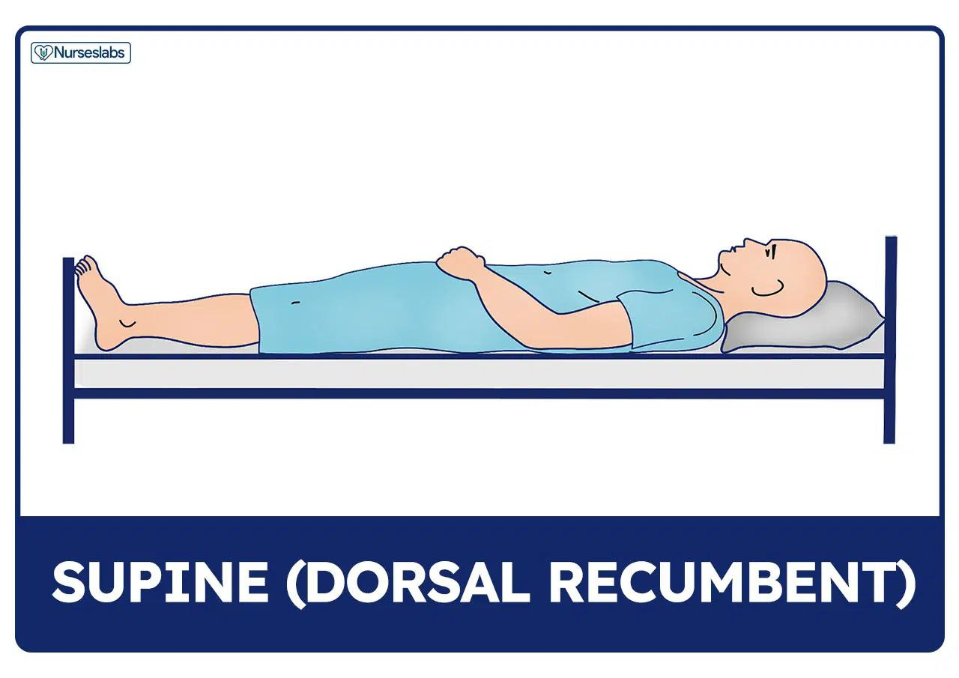
Spine or dorsal recumbent position:
Variation in position.
Most commonly used position.
Watch out for skin breakdown.
Support for supine position.

Slide 7
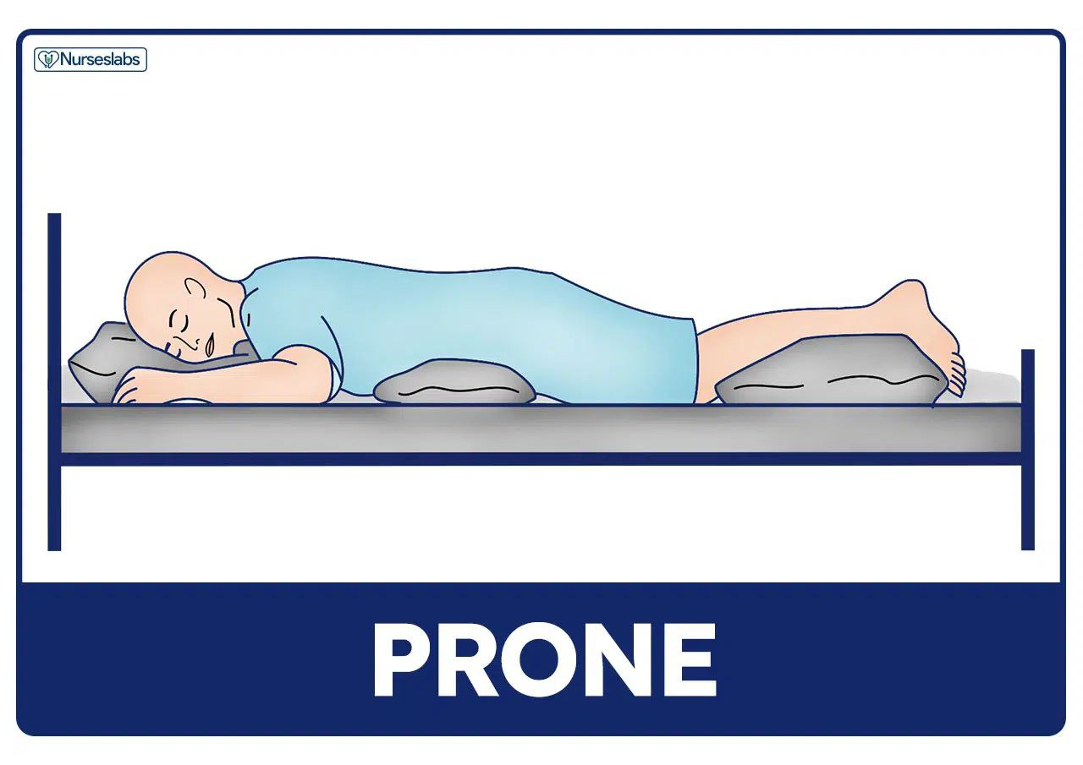
Prone position
In prone position , the patient lies on the abdomen with their head turned to one side and the hips are not flexed .
Extention of hips and knee joints.
Contraindicate for spine problems.
Drainage of secretions.
Placing support in prone.

Slide 8
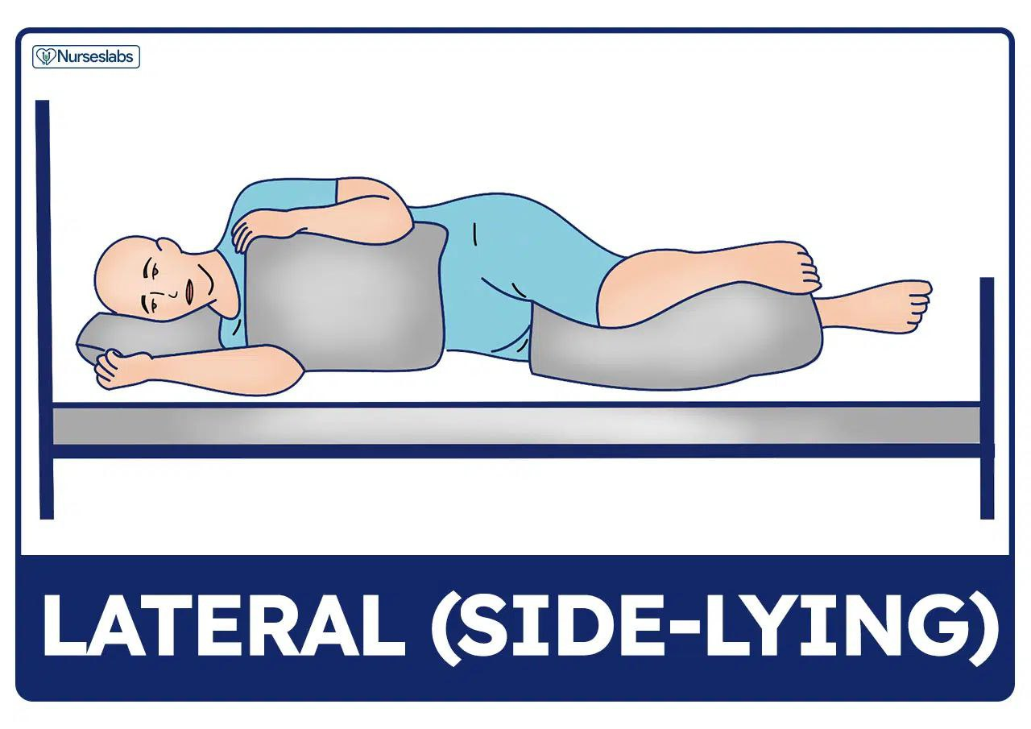
Lateral position
Extention of hips and knee joints.
Body weight disterbution.
Support pillows needed.

Slide 9
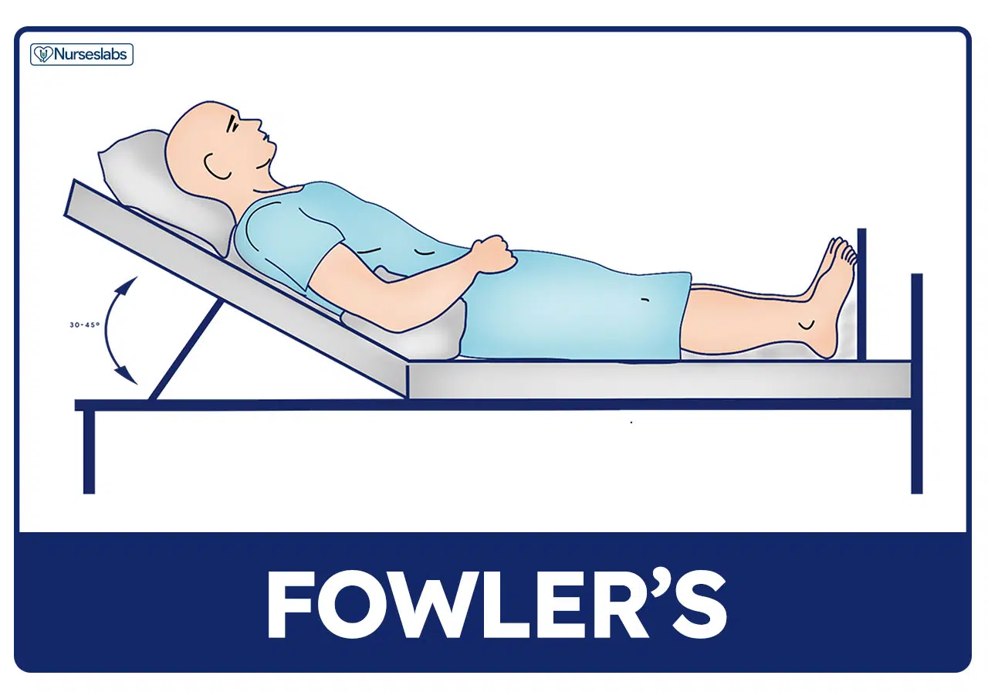
Fowler’s Position
Promotes lung expansion.
Useful for NGT.
Prepare for walking.
Poor neck alignment.
Use a footboard.
Etymology.

Slide 10
Support devices for patient positioning
Bed boards
Foot boots
Hand rolls
Hand_wrist splints
Pillows
Sandbags
Side rails
Trochanter rolls
Wedge pillows

Slide 11
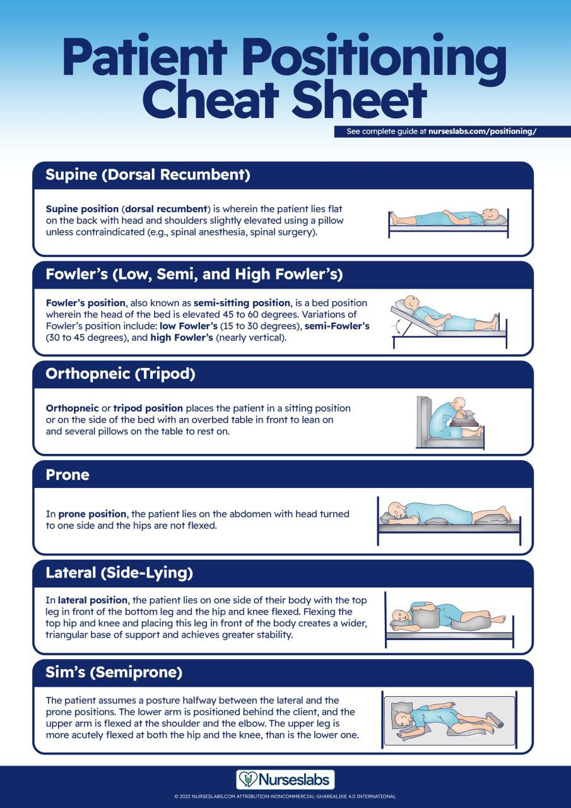

Slide 12
Thank you for watching

