Slide 1

Hypernatremia
Presenter: Mona Ameli
Master: Professor Rasouli

Slide 2
INTRUDUCTIONS
Normal range in ECF(plasma): 135_145 mEq/lit
Normal range in urine: 20 mEq/lit in sample urine test
Hypernatremia: A condition in which the level of plasma Na+ is higher than 145 mEq/lit.

Slide 3

SIGN and SYMPTOMS
Gl : Anorexia, nausea, vomitting .
Integumentary:Skin dry and flushed, mucus membrane dry and rough, body temperature elevated.
Neurologic: Restlessness, agitation, irritability ,lethargy, stupor, coma, Muscle twiching, tremor, hyperreflexia, seizures, rigid paralysis in late stages.
Cardiovascular: Tachycardia, hypotension or hyper tension, erratic heart rate and blood pressure dependent on fluid status.

Slide 4
DIFFERENT TYPES
Hypovolemic ( TBW total body sodium
Hypervolemic (TBW total body sodium
Euvolemic (TBW total body sodium

Slide 5
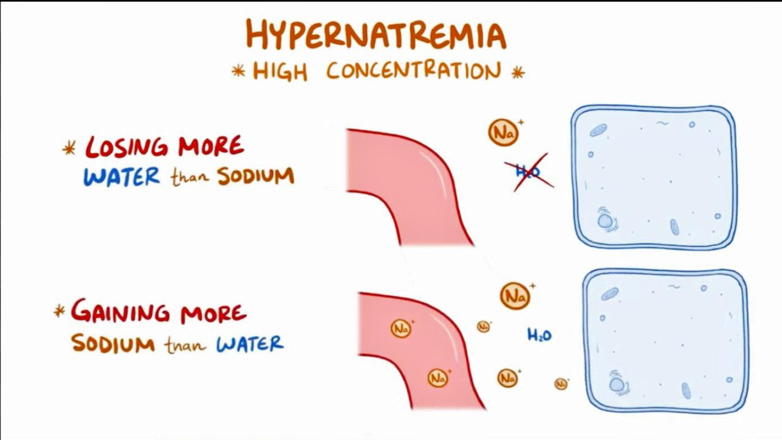

Slide 6
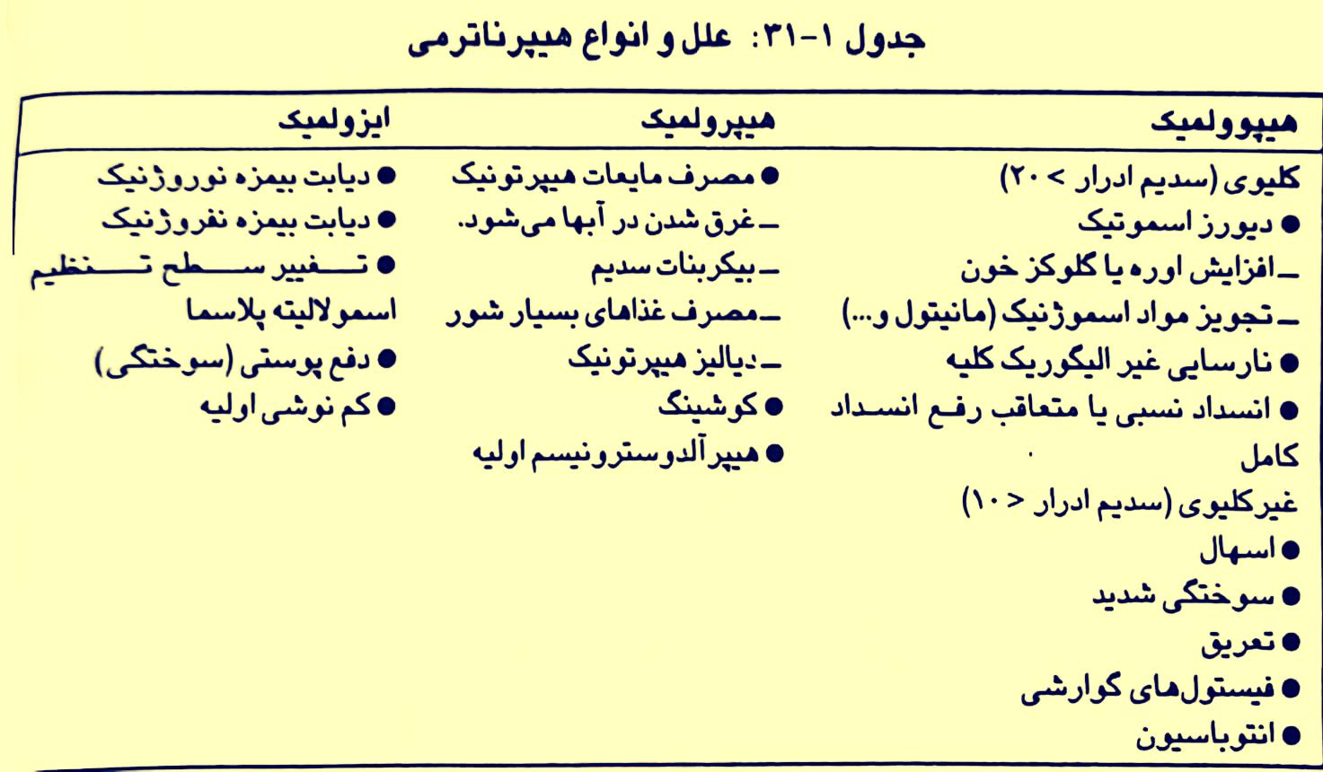

Slide 7
TREATMENT PLAN
Hypovolemic:
Sodium bicarbonate 7.5%
Hypervolemic
Dextrose 5% if GFR is normal
In abnormal GFR use loop diuretics in addition
Euvolemic :
central DI : Water intake and ADH analogue
Nefrogenic DI: water intake and Tyaside diuretics

Slide 8
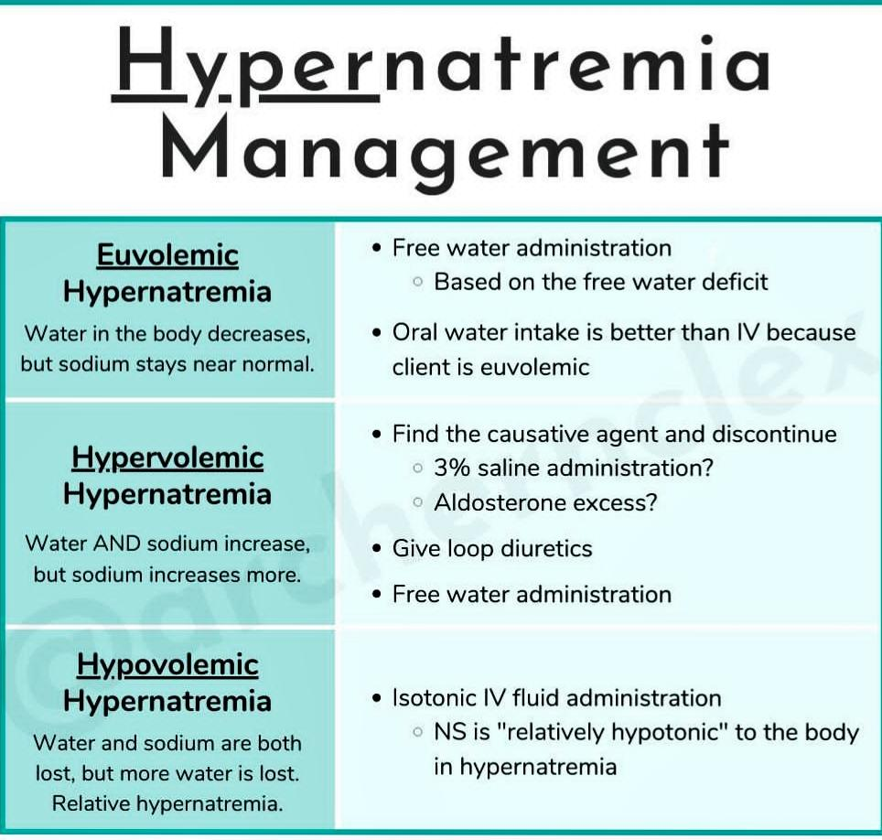

Slide 9
Diabetes Mellitus
HHS | DKA
Type2 | Type I
>40 years | <30 years
Glucose>800 mg /dl | Glucose<600 mg/dl
Na+ norm or high | Na+ norm or low
Hco3 norm | Hco3 low
pH . Norm | pH acidosis
OsM>350 Osm/kg | Osm < 350
Sign: dehydrate/rhabdomyolysis/hyperpnea/fever/polyuria/stupor/hypotension | Sign: tacypenea/ketonemia dehydrate/kussmal/headache/fever/stupor
Ser N/S 1000 ml in 30 min/ insulin | 10-20ml/kg N/S or ringer//0.1 u/kg/hr insulin

Slide 10


