Slide 1

Aspiration Pneumonia
ارائه دهنده:فریبا محمدی
استاد راهنما: استاد جوان

Slide 2
Case report:
بیمار ۶۲ ساله به دنبال مسمومیت با اپیوم با افت spo2, سیانوز،مردمک میوز در تاریخ ۷/۳۰مراجعه می‌کند
T:37, RR:19,PR:108, BP:110/80, SPO2:70%
درمان: O2 تراپی، نالوکسان، ECG, بستری داخلی
ROS:
ادیکت به تریاک،
گیج و خواب آلود، ارتباط چشمی با صدا زدن، ارتباط کلامی در حد تک کلمه و گاه آه و ناله و آگاه به مکان زمان نیست
تاکی کارد ، SPO2:72%
ساعت ۶ صبح همراه بیماربه او تریاک داده که بیمار آسپیره می‌کند:
SPO2:75%,تنفس شکمی HR:105, BP:160/100,RR:30
منتقل ICU

Slide 3
درمان:
اینتوبه
SIMV
ساکشن ترشحات
NGT
NPO
آنتی بیوتیک تراپی
سفتریاکسیون
سیپروفلکساسین
مترونیدازول
یافته های تشخیصی:
CT
VBG
PH:7.21
PCO2:70.4
HCO3:27.1
PO2:44.9
TV:450
PEEP:5
RR:10

Slide 4
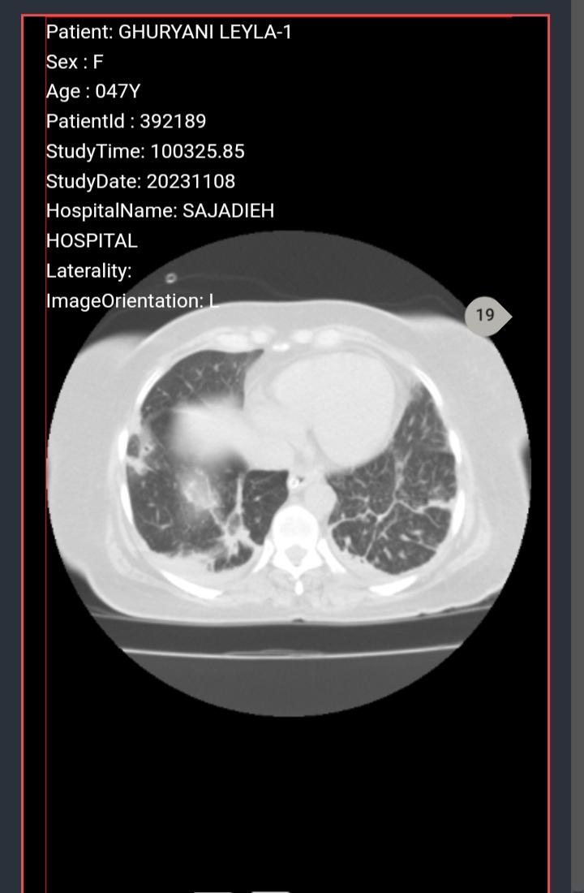

Slide 5
Aspiration Pneumonia
Introduction:
The infectious pulmonary process that occurs after abnormal entry of fluids into the lower respiratory tract is termed aspiration pneumonia.
The mortality rate from aspiration pneumonia is largely dependent on the volume and content of aspirate and can range up to 70%.

Slide 6
Nursing Diagnosis
Dyspnea
Decreased oxygen saturation
Chest discomfort
Tachypnea
Fever
Cough
1
5
2
6
3
7
4
8
Tachycardia
Foul sputum

Slide 7
Causes
Failure of the natural defense mechanisms like the closure of the glottis and cough reflex
altered mental status, neurologic disorders, esophageal motility disorders, protracted vomiting, and gastric outlet obstruction
the common organisms involved in the etiology of community-acquired pneumonia are Streptococci, Haemophilus, and gram-negative bacilli

Slide 8

Assessment
The common clinical features
dyspnea, fever, hypoxemia, radiological findings of bilateral infiltrates, and crackles on lung auscultation in a hospitalized patient
The common site involved depends on the position at the time of aspiration, commonly the lower lobes are involved in an upright position, and superior lobes can be involved in the recumbent position.

Slide 9
Evaluation
The commonly utilized imaging studies are chest x-ray, computed tomography of the chestClinical features may help to distinguish

Slide 10
Medical Management
To prevent further aspiration, the patient’s position should be adjusted, followed by suction of oropharyngeal contents with the placement of the nasogastric tube
In patients who are not intubated, humidified oxygen is administered, and the head end of the bed should be raised by 45 degrees
Close monitoring of the patient's oxygen saturation is important
Flexible bronchoscopy is usually indicated for large volume aspiration to clear the secretion and also for obtaining the sample of bronchoalveolar lavage for quantitative bacteriological studies
The choice of antibiotics for community-acquired aspiration pneumonia are ampicillin-sulbactam, or a combination of metronidazole and amoxicillin can be used.

Slide 11
Nursing Management
Ensure swallow screen done before feeding
If NG tube placed for feeding, make sure chest x-ray is done to confirm the position
Check arterial blood gas to ensure oxygenation is adequate
Administer antibiotics as ordered
Protect airway
Suction if thick secretions
Provide oxygen
Position patient upright
Monitor vitals
Listen to lung sounds

Slide 12

When To Seek Help
If oxygen desaturation
Hypotension
Respiratory distress
Coughing
Fever

Slide 13

Outcome Identification
Able to eat food without aspiration
No coughing spells
No respiratory distress
Normal vitals
Chest x-ray is clear

Slide 14
Is the Glasgow coma scale LESS than13??
1
Is there facial Asymmetry / weakness??
2
Is there tongue Asymmetry / weakness??
3

Slide 15
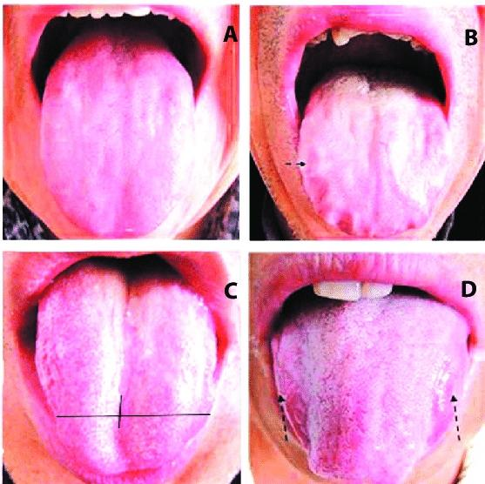

Is there Palatal Asymmetry / weakness?
4

Slide 16
Are there signs of aspiration during the 3 Oz. Water test?

Slide 17
Thank you for your attention

