Slide 1
Compartment syndrome
Presenter: Mona Ameli
Master: Professor Rasouli

Slide 2
COMPARTMENT
INTRUDUCTIONS:
A well-defined region that contains a group of muscles within a particular segment of the body.
For example, the lower leg contains four muscle compartments: the anterior compartment, lateral compartment, posterior deep leg compartment, and posterior superficial compartment.
There are 46 compartments in human body in which 36 are in the distal upper and lower extremities.
The normal pressure in a compartment is 8 mlHg or less.
The pressure can be measured by manometer or Stryker.

Slide 3
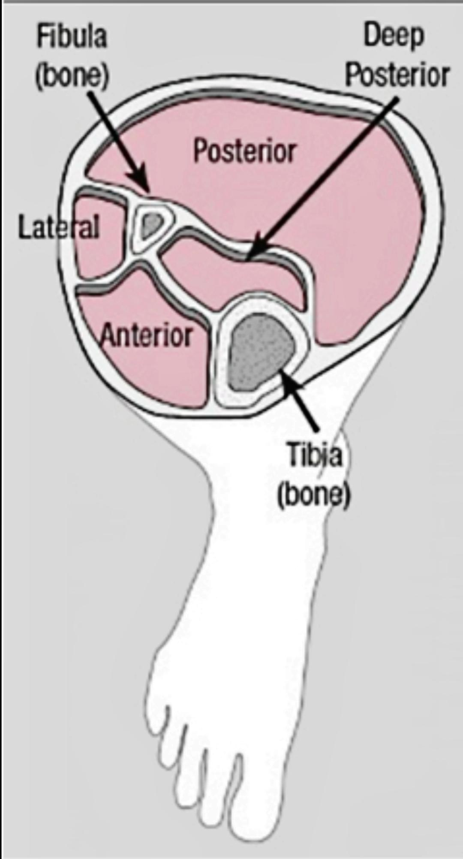

Slide 4
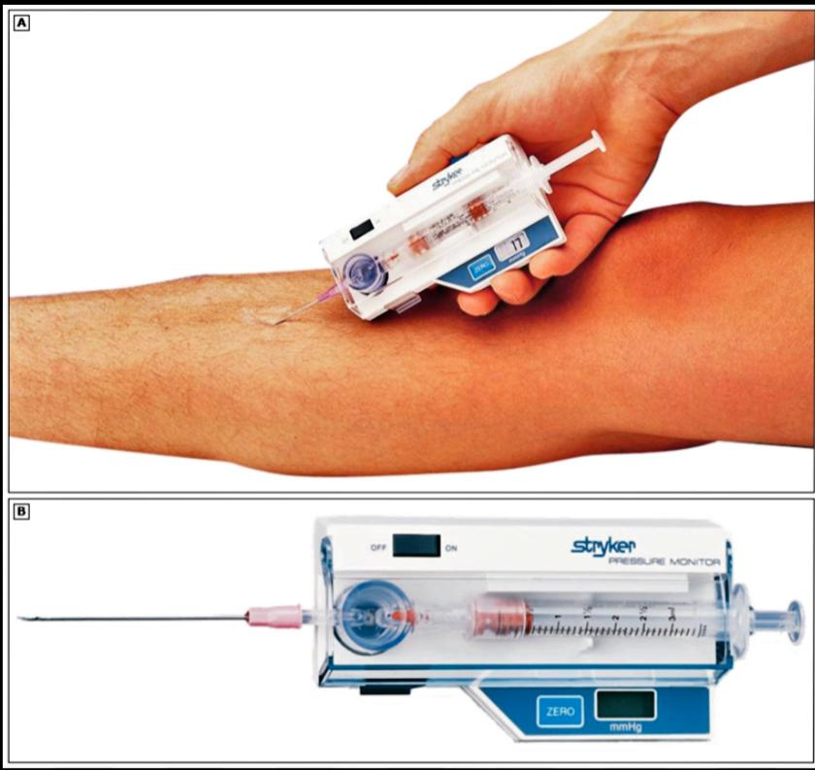
The Stryker System

Slide 5
Compartment syndrome
INTRUDUCTIONS:
A painful and threatening condition that occurs when the internal pressure in the compartment increases and can lead to decreased blood flow or damaged nerves.
CAUSED BY:
Internal:
Fracture
Edema
Hematoma
External:
Burns
prolonged immobilization
tight wrapping

Slide 6
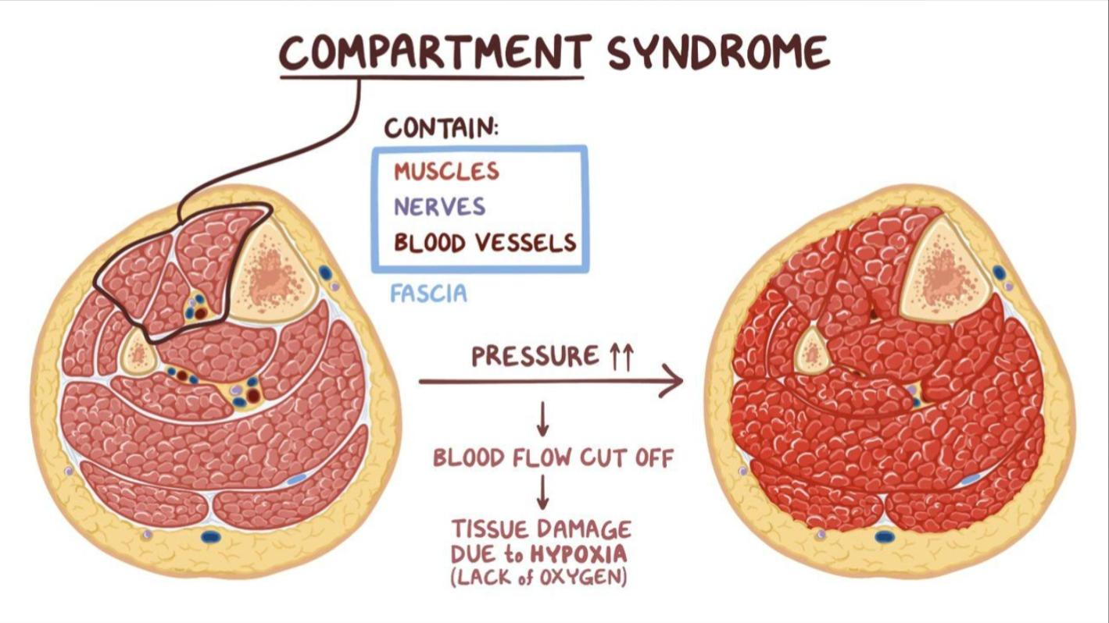

Slide 7
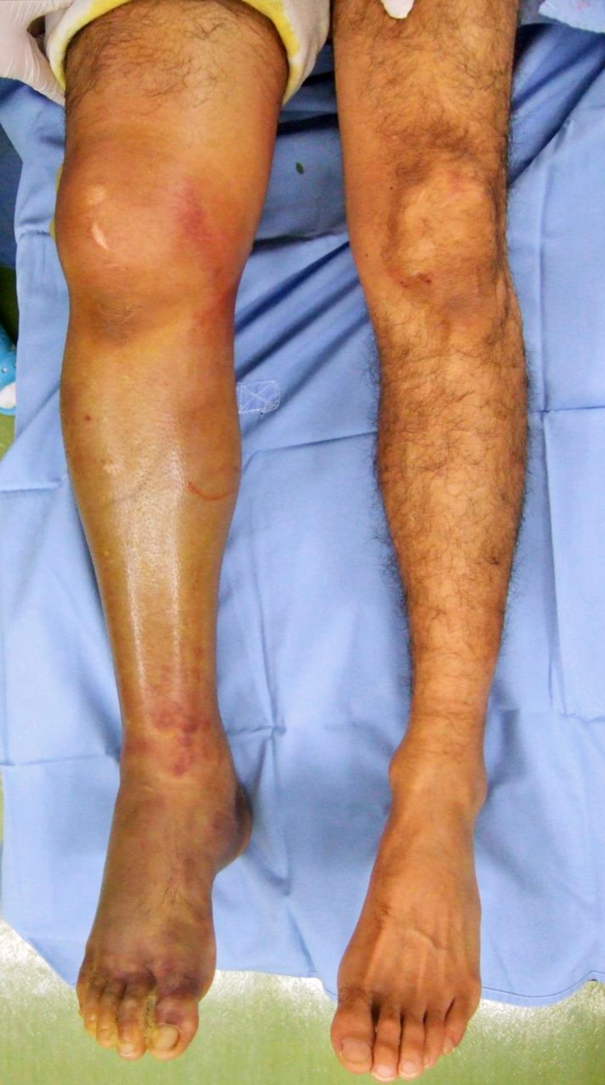
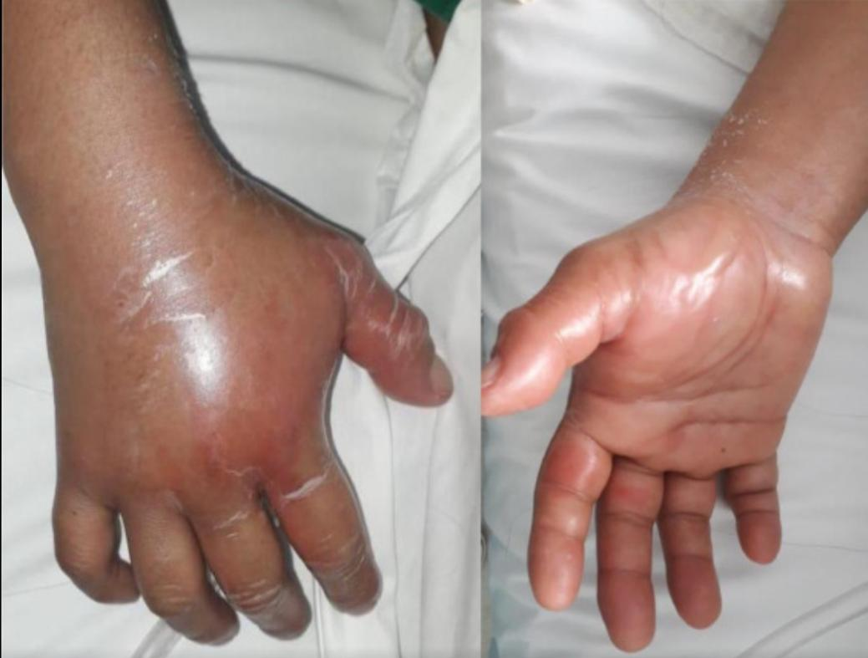

Slide 8
SIGN and SYMPTOMS
Pain
Weakness
Paralysis
Paresthesia
Tightness
Pallor
Infection
Limb loss
Necrosis
Rhabdomyolysis
Amputation

Slide 9
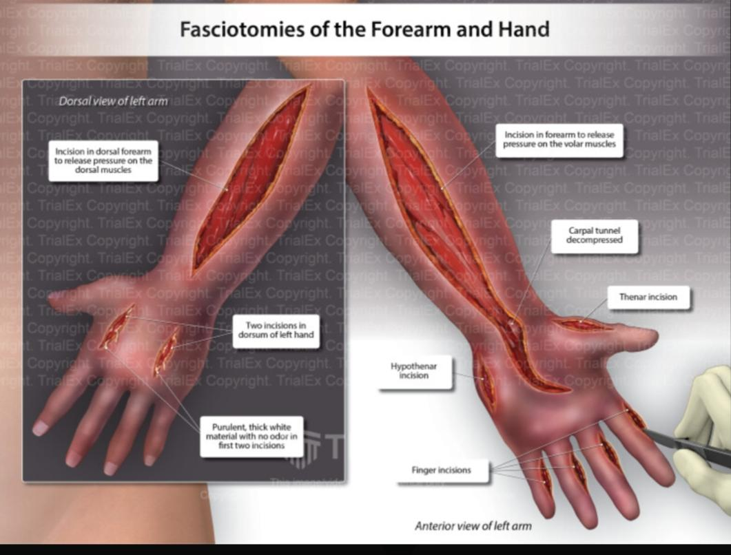
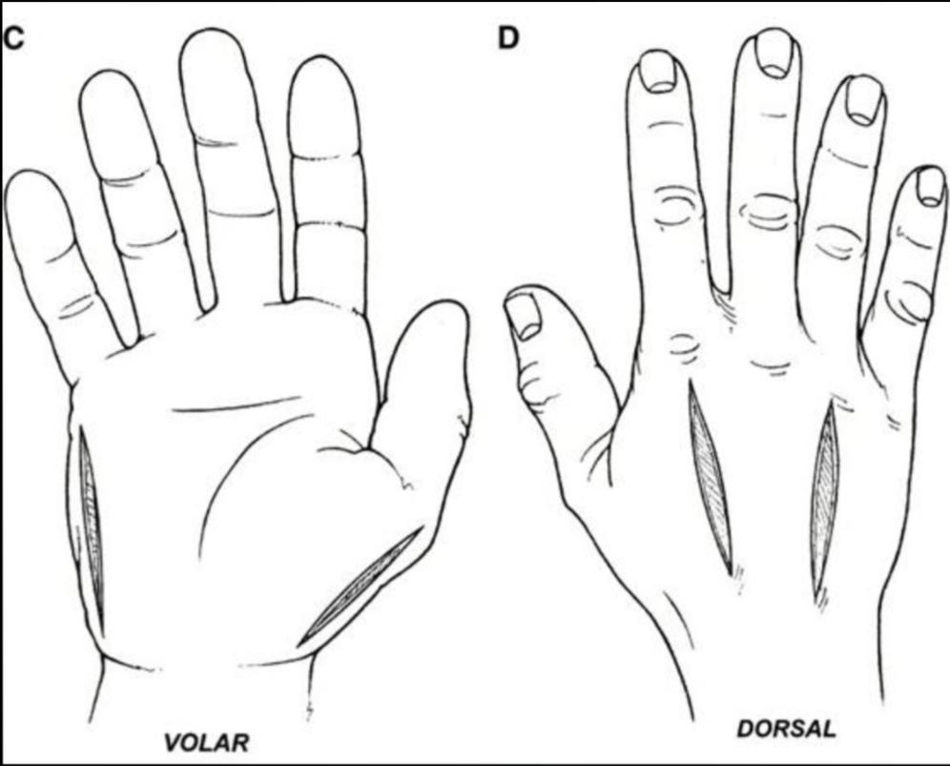
Fasciotomy

Slide 10
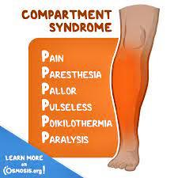
Nursing care
Check pain and 6 P’s
Check neurovascular statue(CMS)
Circulation
Motion
Sensation
Check I & O (For rhabdomyolysis)
Teach emergency situation and infection signs

