Slide 1
Right atrial clot and pulmonary embolism in a patient with COVID-19: A case report
Supervisor Dr raeisi
Provider naeimeh soltani

Slide 2
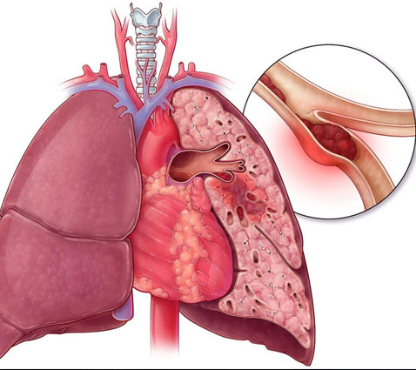

Slide 3
What is pulmonary embolism?
Pulmonary embolism is the presence of a blood or fat clot, rarely in one of the arteries that supply blood to the lung tissue.
Blood is initially formed in one of the deep veins of the lower limb or pelvis. Fat embolism usually follows a bone fracture
A blood clot or fat embolus is created through the blood stream and by passing from the heart to one of the blood vessels.
Lung tissue matures and settles there. This phenomenon causes
Obstruction of said vein and as a result reducing the ability to breathe and sometimes
Destruction of lung tissue causes pulmonary embolism at all ages
can occur, but it is more common in adults.

Slide 4
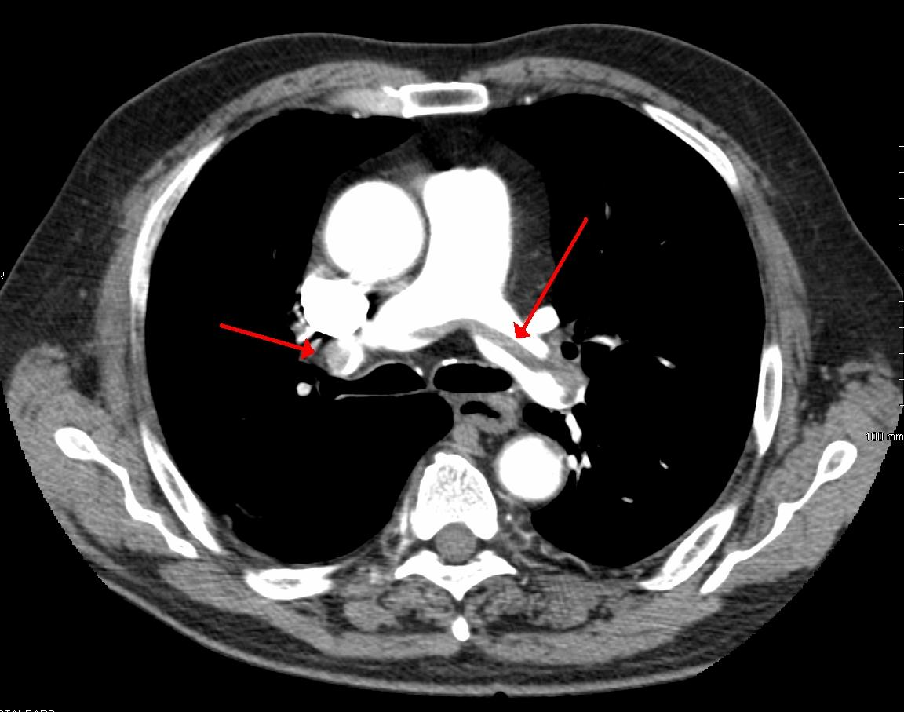

Slide 5
Common symptoms
Common symptoms
Shortness of breath, sudden cessation of breath
Chest pain
Cough sometimes accompanied by bloody sputum
Rapid heart rate
mild fever
Before the onset of the above symptoms, usually swelling and pain in the lower limbs

Slide 6
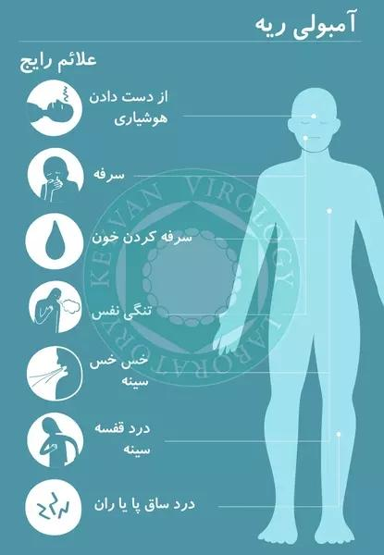

Slide 7
reasons
Blood clots in the deep veins whenever the blood inside
A vein that is accumulated and does not flow well can cause it
to be

Slide 8
Risk factor
Heart rhythm disorders
Increased blood concentration
Bone fracture
obesity
pregnancy
Taking pregnancy pills, especially in women who smoke
smoking
Types of cancer
Risk factors
Age over 60 years
Any injury or illness requires a long rest bed
Sitting in a fixed position for a long time, for example in
while traveling by plane
Recent surgery
congestive heart failure

Slide 9
Prevention
prevention
1- From long-term rest in bed during illness
Avoid moving your lower limbs and walking as soon as possible after surgery. During the recovery period, use stockings, both during bed rest and when getting up bed).
2- Refrain from smoking, especially in women
35 years old and above who take birth control pills
During the journey, stand and walk for a while every 1-2 hours
4 Taking an aspirin a day may have a preventive role in this field, consult your doctor about this

Slide 10
Possible side effects
Sudden death due to a large clot blocking more than 50 blood vessels in the lungs. Severe intrapulmonary bleeding from smaller clots
diagnosis
In addition to clinical examinations, diagnostic examinations include chest radiograph, lung scan, lung angiography, ECG and testsBlood can help.

Slide 11
The goal of treatment is
:
Maintaining the heart and lung function at an acceptable level until the clot is removed and preventing the recurrence of embolism
Non-pharmacological treatment
1- Surgery is possible to close the large vein leading to the heart and lungs, the vena cava by placing a strainer in it.
Necessary to prevent clots from passing to the hear
be (rarely)
2-Using a sock or wrapping the leg with a bandage
3_ Place your feet above the bed level while sleeping.

Slide 12
Drug treatment
1Anticoagulants are effective in dissolving the clot and preventing it from forming again. The effectiveness of anticoagulants should be measured regularly to ensure that their levels are optimal
Straight line.
2. Administration of oxygen if needed
During rest in bed lower limbs
Move frequently to get the blood flowing in them be helped

Slide 13
Tell your doctor if the following occur during treatment See
- Cough with bloody sputum
- Intensification of leg swelling and pain
Chest pain
shortness of breath
Bleeding from different parts of the body, such as bruising of the skin, vomiting, blood in the urine, bleeding from the gums, etc
Abnormal nose and vaginal bleeding

