Slide 1
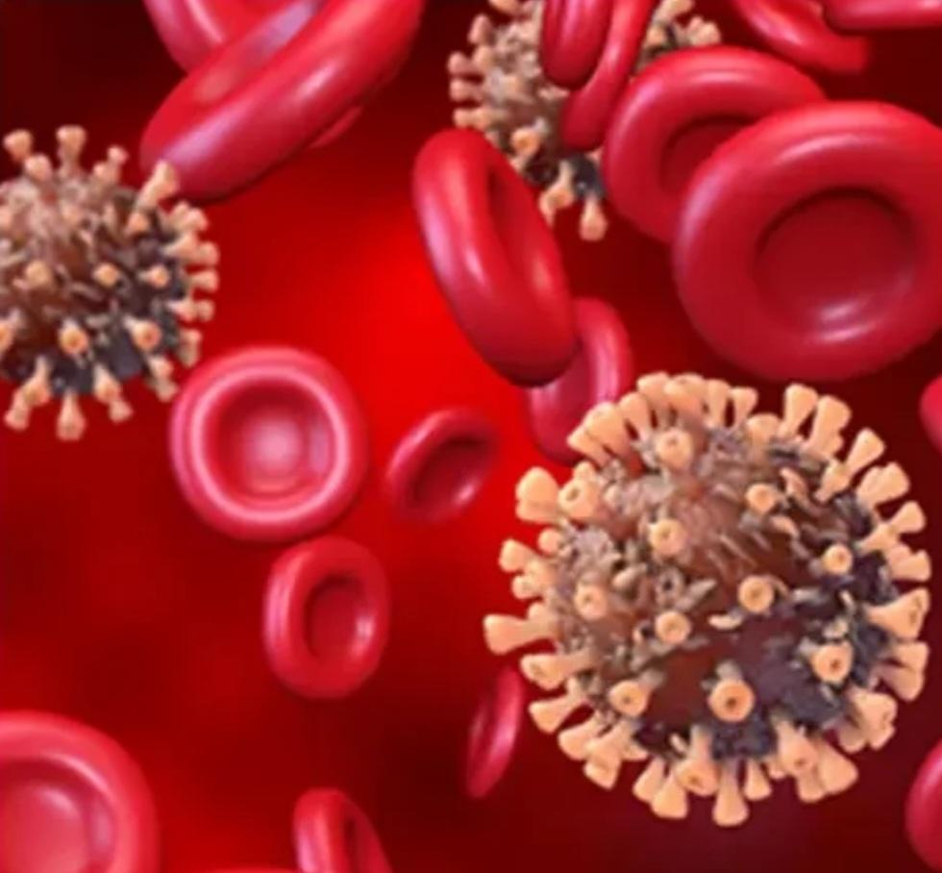
IN THE NAME OF ALLAH
Advisor:Mr.Rasoli
Presenter:shabnam poshti
Acute myocardial infraction
secondary to Covid-19 infection

Slide 2
Onset and Prevalence:
In the city of Wuhan in china
The year 2019

Slide 3
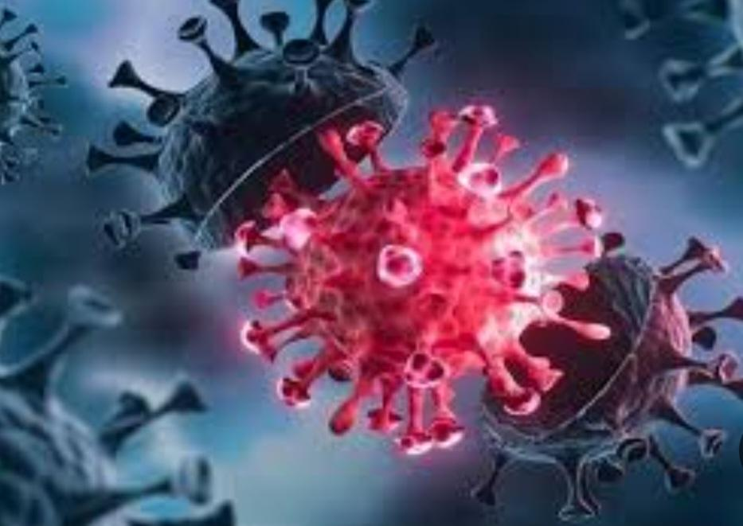
Ways of virus transmission:
Respiratory system
Fecal-oral route
Incubation period:
4_7 day

Slide 4
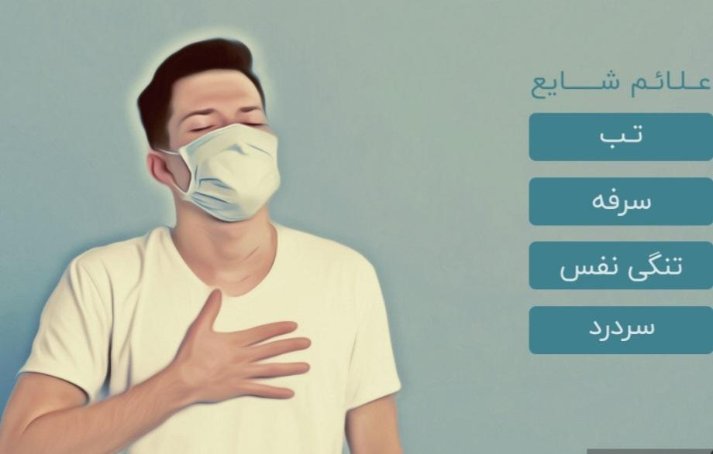
Clinical Protests:
The most common symptoms:
Fever(87/9%)
Cough(67%)
Tirednesss(38%)
Diarrhea(5%)
Vomit(3/7%)

Slide 5
Diagnostic Ways:
Clinical sings
PCR
RT-PCR
Blood test
CT ,Lung X-ray

Slide 6
The most important causes of death:
1)Acute Respiratory failure syndrome
2)Acute multiple organ failure syndrome

Slide 7
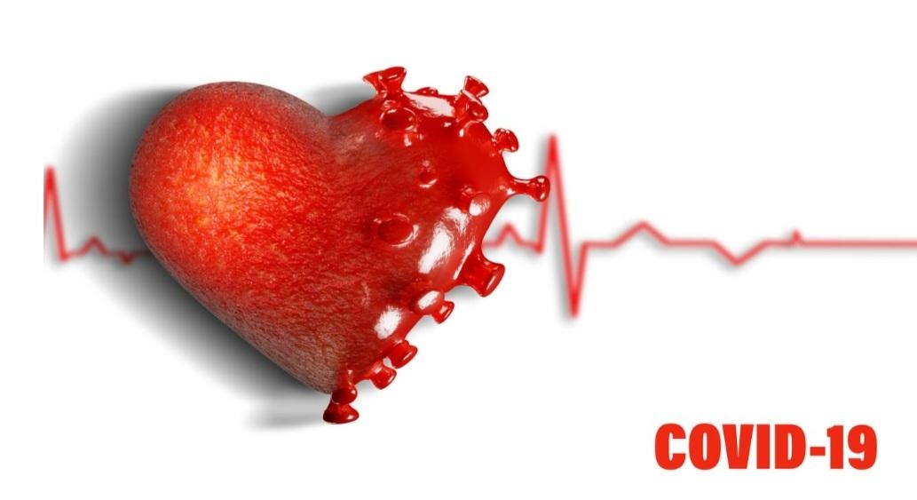
How Corona affects the heart and causes ACS and MI?
1)Decreased oxygen supply due to Respiratory system disorders
2)Increased risk of clot production
3)Direct damage to the heart muscle

Slide 8
Thank you for your attention
🩺💊🩸🩹💉🚑🏨👩‍⚕️

