Slide 1
In the name of Merciful God
Diverticulitis and peritonitis caused by it.
Persent by Erfan Poorhang
Master: Mohammad Sajjad Ghaderi

Slide 2
Complications of diverticulitis
3
2
1
fistula
peritonitis
diverticulum

Slide 3
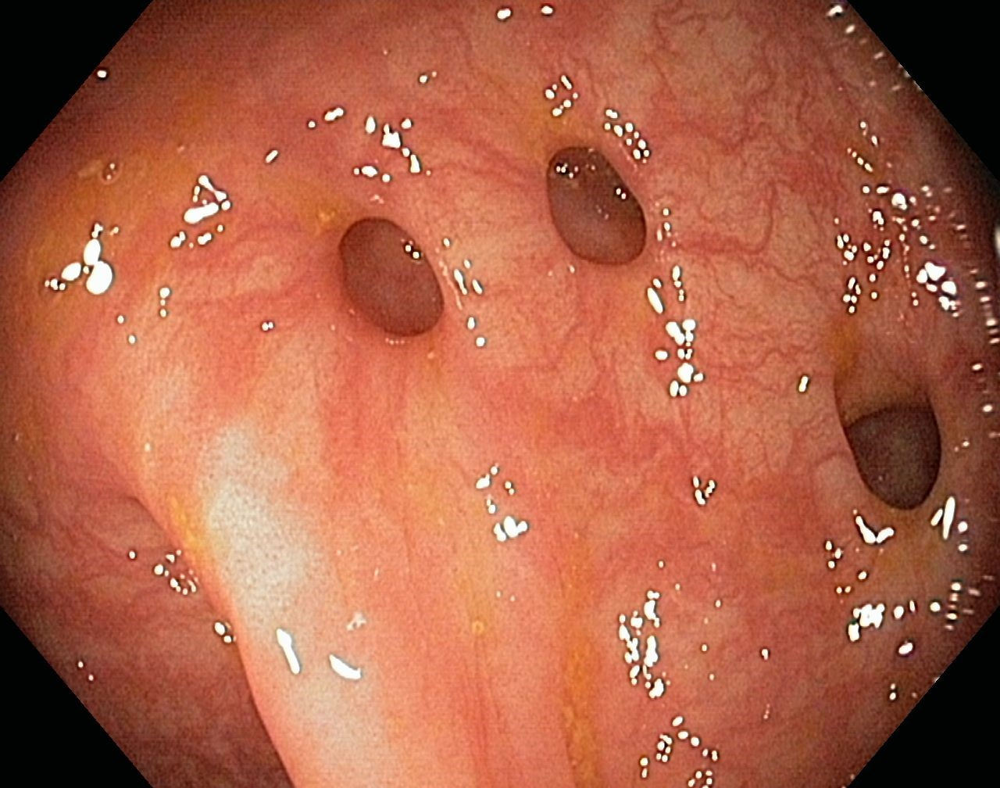
Introduction
In general, a diverticulum means a bag-like protrusion of a part of the digestive tract due to a defect in the muscular layer.
The most likely place to create a diverticulum is in the sigmoid colon.
Diverticulosis
diverticulitis

Slide 4
Clinical protests
Constipation
Irregular bowel activity
Crampy pain in the lower left quadrant of the abdomen
Fever
Leukocytosis
Weakness and fatigue
Anorexia

Slide 5
diagnosis
Colonoscopy
CT scan with contrast material
Complete globular count
UC

Slide 6
Treatment measures
Antibiotic therapy
Palliative treatment
Surgical treatment

Slide 7
Nursing measures
Patient education:
Drink plenty of fluids
High fiber diet
Teaching exercise to strengthen the tone of the abdominal muscles
Caring for a patient with an ostomy

Slide 8
Thank you

