Slide 1
Giant Hydronephrosis
Created by: Mohadeseh Daneshyar
Tutor: Mr. Rasouli

Slide 2
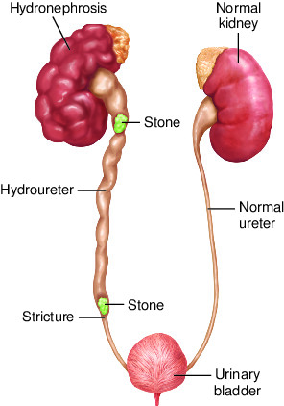
Definition
Giant hydronephrosis is a term used to describe an extremely enlarged or dilated renal pelvis and calyces due to the obstruction of urine flow from the kidney to the bladder. This condition can lead to significant swelling and distension of the kidney, resulting in pain, decreased kidney function, and potential complications if not treated promptly.

Slide 3
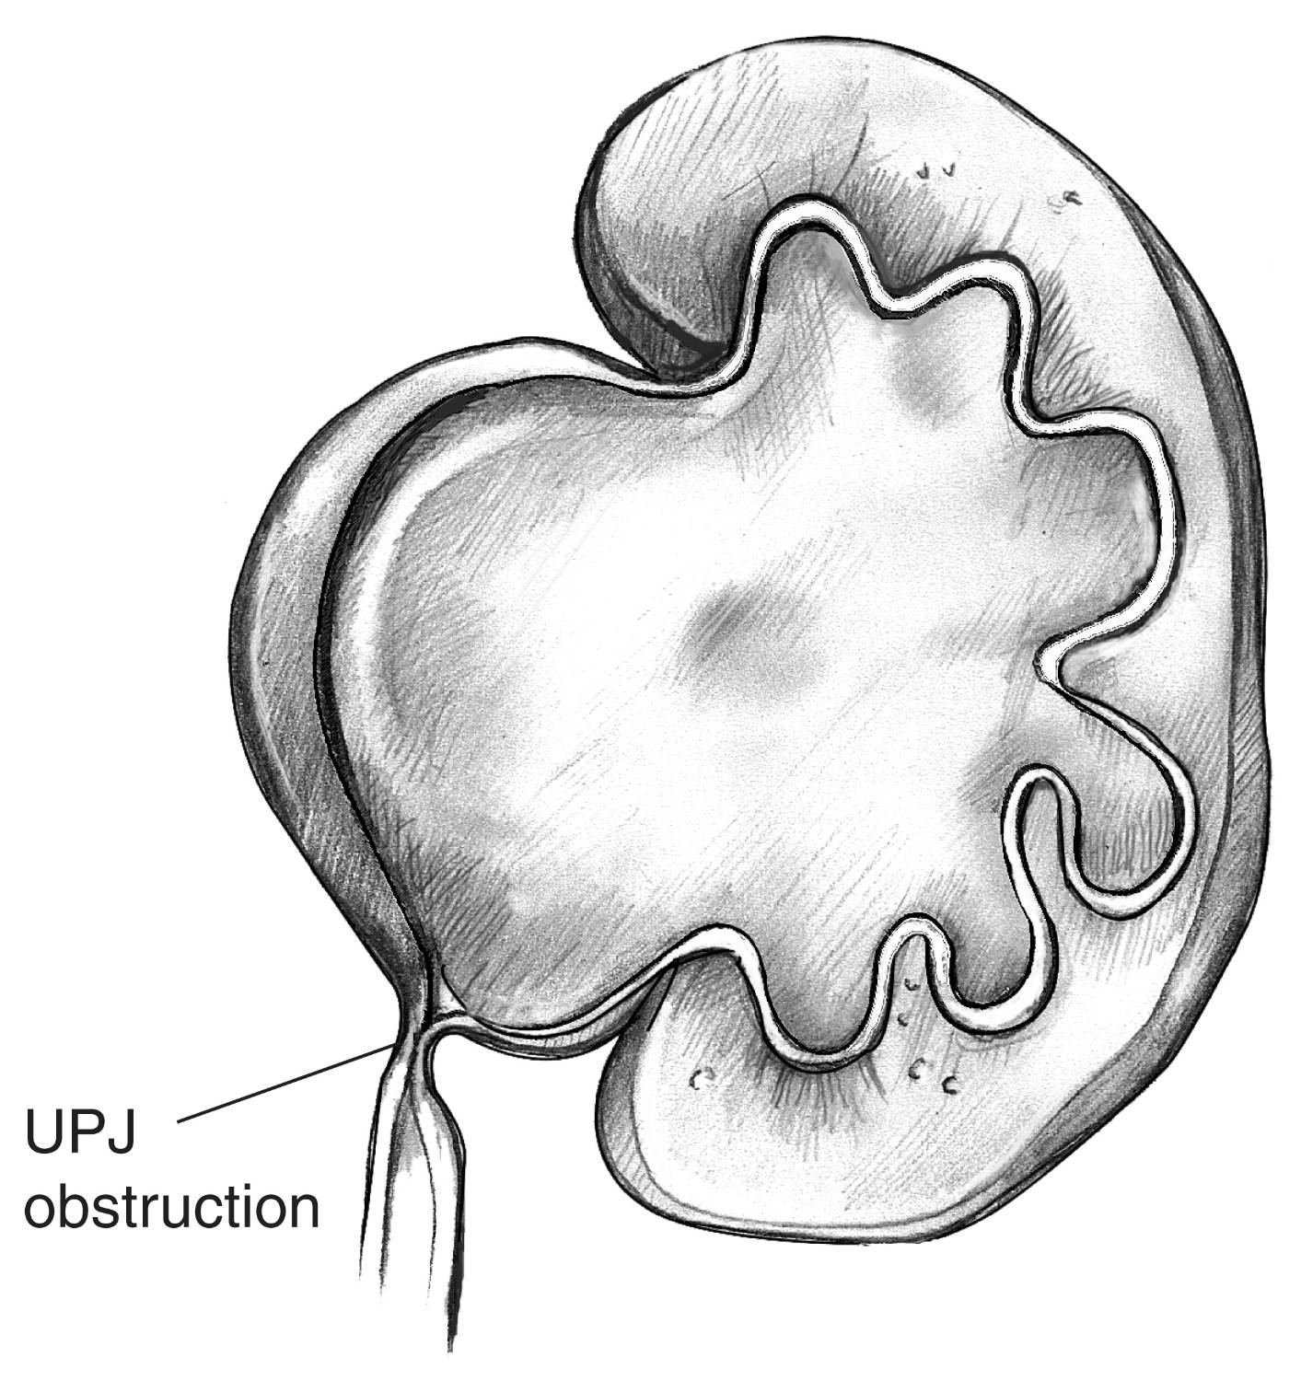

Slide 4
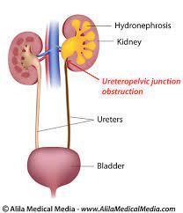

Slide 5
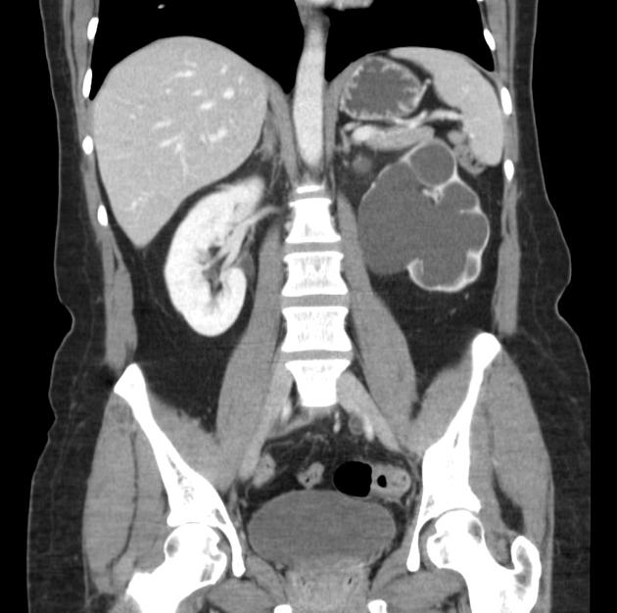

Slide 6
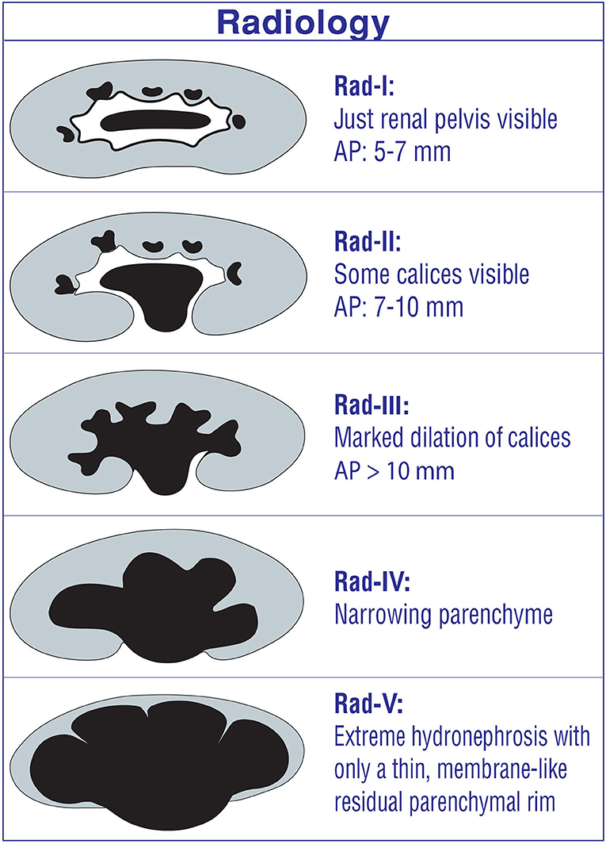
Grade 1: Mild hydronephrosis, with minimal dilation of the renal pelvis and calyces.
Grade 2: Moderate hydronephrosis, with moderate dilation of the renal pelvis and calyces.
Grade 3: Severe hydronephrosis, with marked dilation of the renal pelvis and calyces, as well as thinning of the renal parenchyma.
Grade 4: Very severe hydronephrosis, with gross dilation of the renal pelvis and calyces, significant thinning of the renal parenchyma, and potential loss of kidney function.

Slide 7
Sign and symptoms
01
02
03
04
05
06
Pain
Enlargement
Nausea and vomit
Severe abdominal or
flank pain
Swelling or Enlargement of
kidney area
Frequent
urination
Hematuria
Fever

Slide 8
Etiology
The etiology of giant Hydronephrosis, is usually related to an obstruction in the urinary tract. This obstruction can be caused by various factors, including:
Kidney stones
Tumors
Congenital anomalies
Scarring
Enlarged prostate
Pelvic masses

Slide 9
Treatment
Nephrostomy: A procedure in which a tube is inserted through the skin into the kidney to drain urine and relieve pressure. Ureteral stenting: Placing a stent in the ureter to help the urine flow from the kidney to the bladder. Surgery: In some cases, surgery may be needed to remove the blockage or repair the underlying issue causing the hydronephrosis. Medication: Depending on the cause of the hydronephrosis, medication may be prescribed to treat infections, reduce inflammation, or manage other symptoms.

