Slide 1
In the name of GOD

Slide 3
The total number of cases in different countries has reached 700 million so far, and 6 million deaths have been confirmed.
The total number of COVID-19 cases in the country to date has risen to 7,626,689
The total number of deaths from this disease has reached 146837.

Slide 4
Children are sensitive at any age to coronavirus disease 2019 (COVID-19) and are at risk of being infected

Slide 5
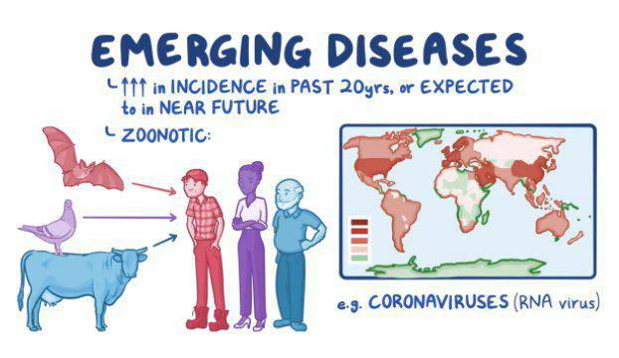

Slide 15
Nursing diagnosis
“Impaired gas exchange related to increased pulmonary secretions, receiving sedative drugs, and immobility as evidenced by crackle and decrease in SaO2”
“Risk of ineffective breathing pattern related to the displacement of tracheal tube”
“Risk of hyperthermia related to COVID-19 as evidenced by fever”

