Slide 2
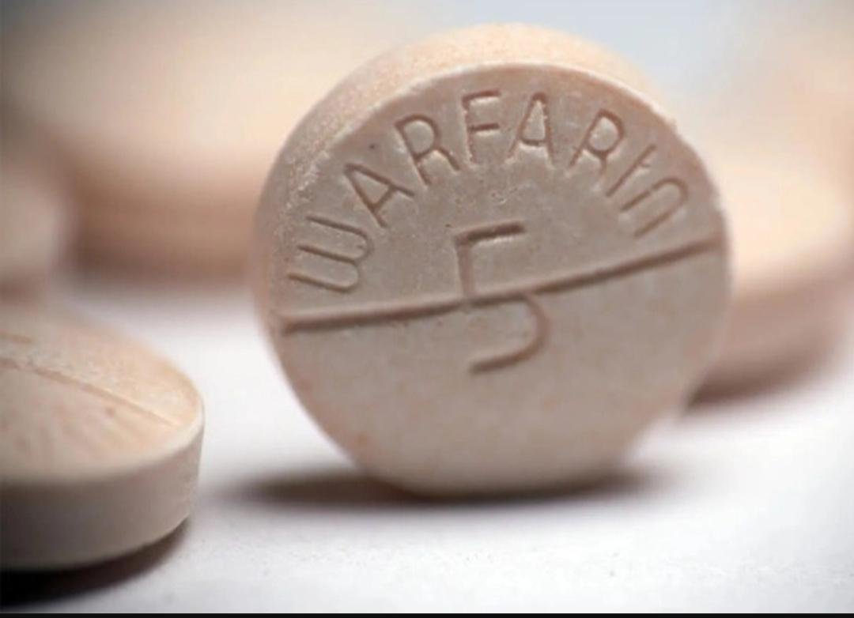

Slide 3
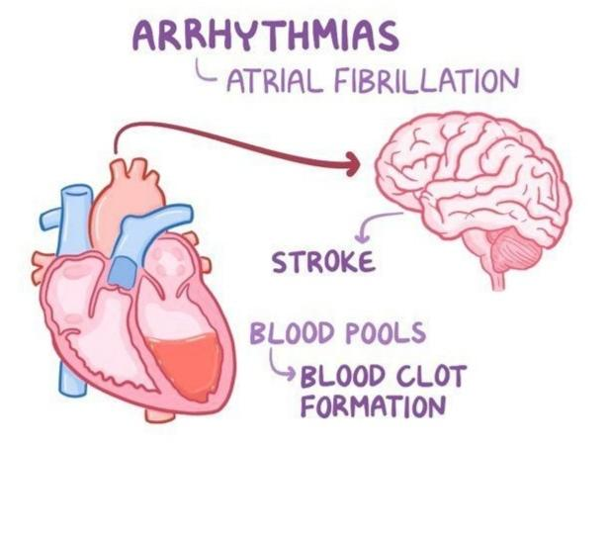
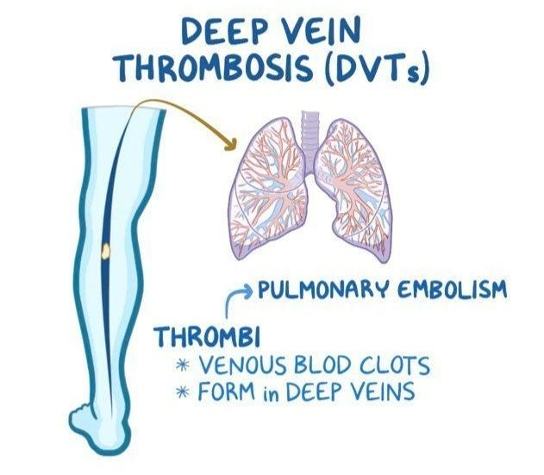
Warfarin, also known by the brand names Coumadin or Jantoven, is an anticoagulant drug that is used as an oral and sometimes injectable anticoagulant to treat blood clotting problems (such as deep vein thrombosis). and pulmonary embolism) or prescribed to prevent blood clots.

Slide 4
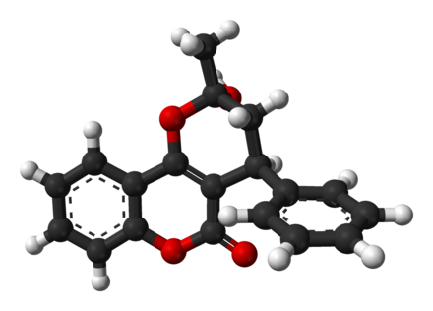
Mechanism of action
Disorder in the metabolism of vitamin K in the liver. By inhibiting the activity of vitamin K, warfarin inhibits coagulation factors that require vitamin K for their activity. In the subsequent processes, this will reduce the level of materials necessary to maintain the fibrin strands. These events reduce the possibility of clot formation.

Slide 5
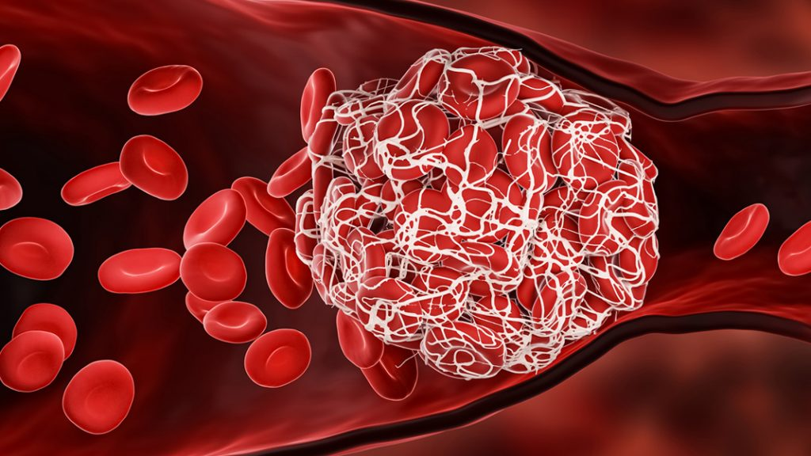
Indications
1_prevention and treatment of venous thromboembolism
2_pulmonary embolism
3_ atrial fibrillation (a type of cardiac arrhythmia)
4_ thromboembolism with heart valve replacement
5_Adjuvant therapy to reduce mortality, recurrent
myocardial
6_infarction and thromboembolic events after myocardial infarction.
7_Secondary prevention of stroke and transient ischemic attacks in patients with rheumatic mitral valve but without atrial fibrillation.
8_Conditions that increase the risk of blood clots:
A special type of irregular heart rhythm (atrial fibrillation)
Heart valve replacement
Recent heart attact Special surgeries (such as hip/knee replacement)

Slide 6
Diseases and factors that increase the risk of bleeding include
1_Uncontrolled blood pressure
2_History of stroke
3_kidney problems
4_alcoholic drinks
5_liver disease
6_Increased risk of tripping and falling
7_Heart valve replacement
8_Stomach ulcer, gastritis and other digestive diseases
9_Cancer or low blood cell count
10_Accident or surgery
11_Some surgeries such as hip/knee replacement
12_Age over 65 years
13_congestive heart failure
14_Inherited clotting deficiency

Slide 7
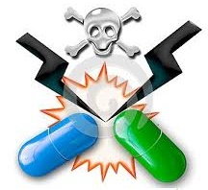
Common medications that interact with warfarin include
1_Aspirin and drugs containing it
2_Acetaminophe or products containing it
3_Antacid drugs (omeprazole, pantoprazole, etc.) or laxatives
4_Many antibiotics such Ciprofloxacin (Cipro)
erythromycin (erythrosin)
5_Antifungal medications such as fluconazole (diflucan) metronidazole (Flagyl)
6_Ibuprofen or naproxen
7_Phenytoin (Dilantin)’Phenobarbital. …

Slide 8
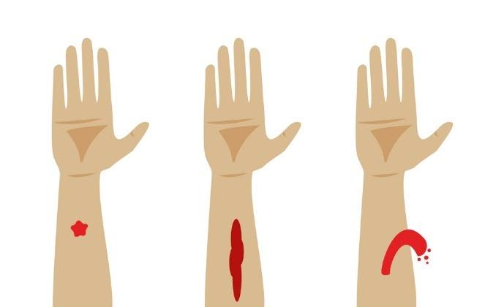
Warfarin overdose symptoms include the following
1_Redness of stool or presence of blood in stool
2_Coughing up blood or bloody sputum
3_Heavy menstrual bleeding
4_Dark brown, red or pink urine
6_Vomiting like coffee beans
7_Purple finger syndrome Small, flat, red spots around the skin
8_Unusual bruising and bleeding
9_Heavy bleeding from small cuts.
❌Any abnormal bleeding
while taking warfarin should be taken seriously

Slide 9
Nursing considerations
6_Teach the patient to reduce the risk of bleeding, recommend using a soft toothbrush, electric razor, etc.
1_Be sure to evaluate the patient's medical records
2_Warfarin blood level control with a test called pt/iNR
Normal inr in the range of 2-3
Below 1/8, the risk of coagulation is high
Above the therapeutic range, the risk of bleeding
3_Avoid intramuscular injections.
4_Assess regularly for signs of blood loss
(petes, bleeding gums, bruising, dark stools, dark urine).
5_Keep vitamin K readily available in case of overdose.

