Slide 1
Anaphylaxis shock
ارائه دهنده: محمدامین باشتنی استاد راهنما: استاد غلامی

Slide 2
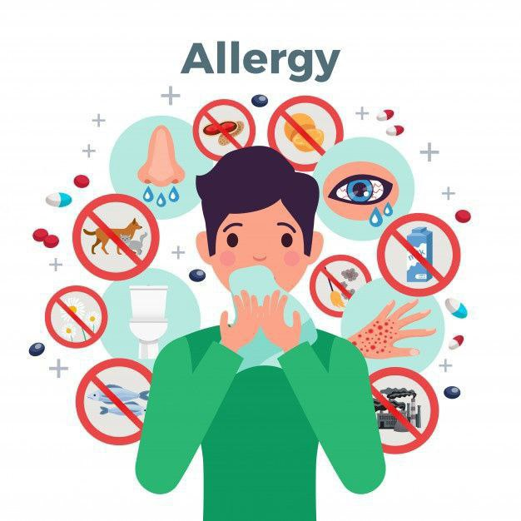

Slide 8
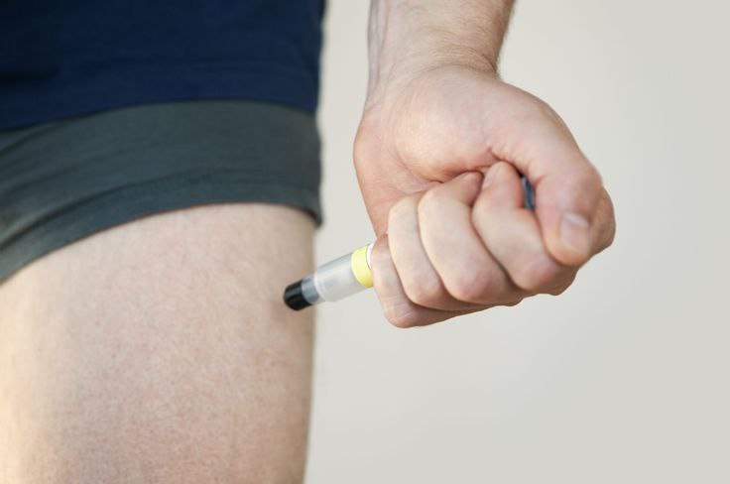
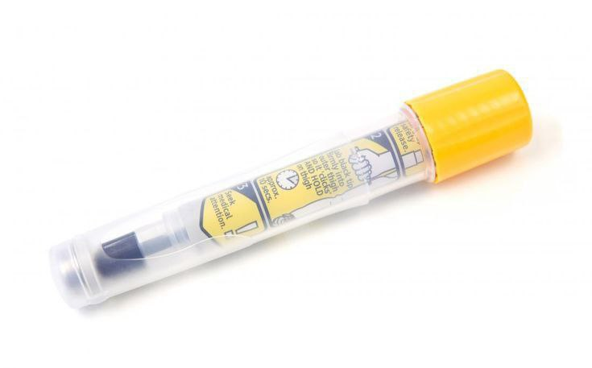

Slide 11
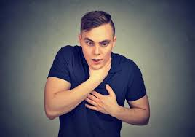
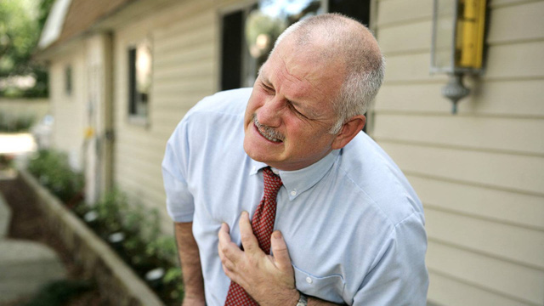

Slide 15
Place the victim in shock position
Keep the person warm and comfortable
Turn the victim’s head to one side if neck injury is not suspected

