Slide 1
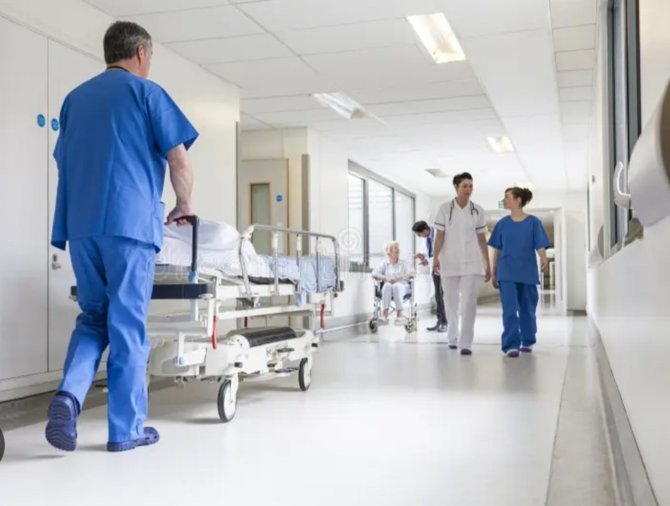
Riehl’s interaction model
Professor : Mr.Rasouli
Presenter :F.Hashemi
Notes:
https://rashasite.ir

Slide 2
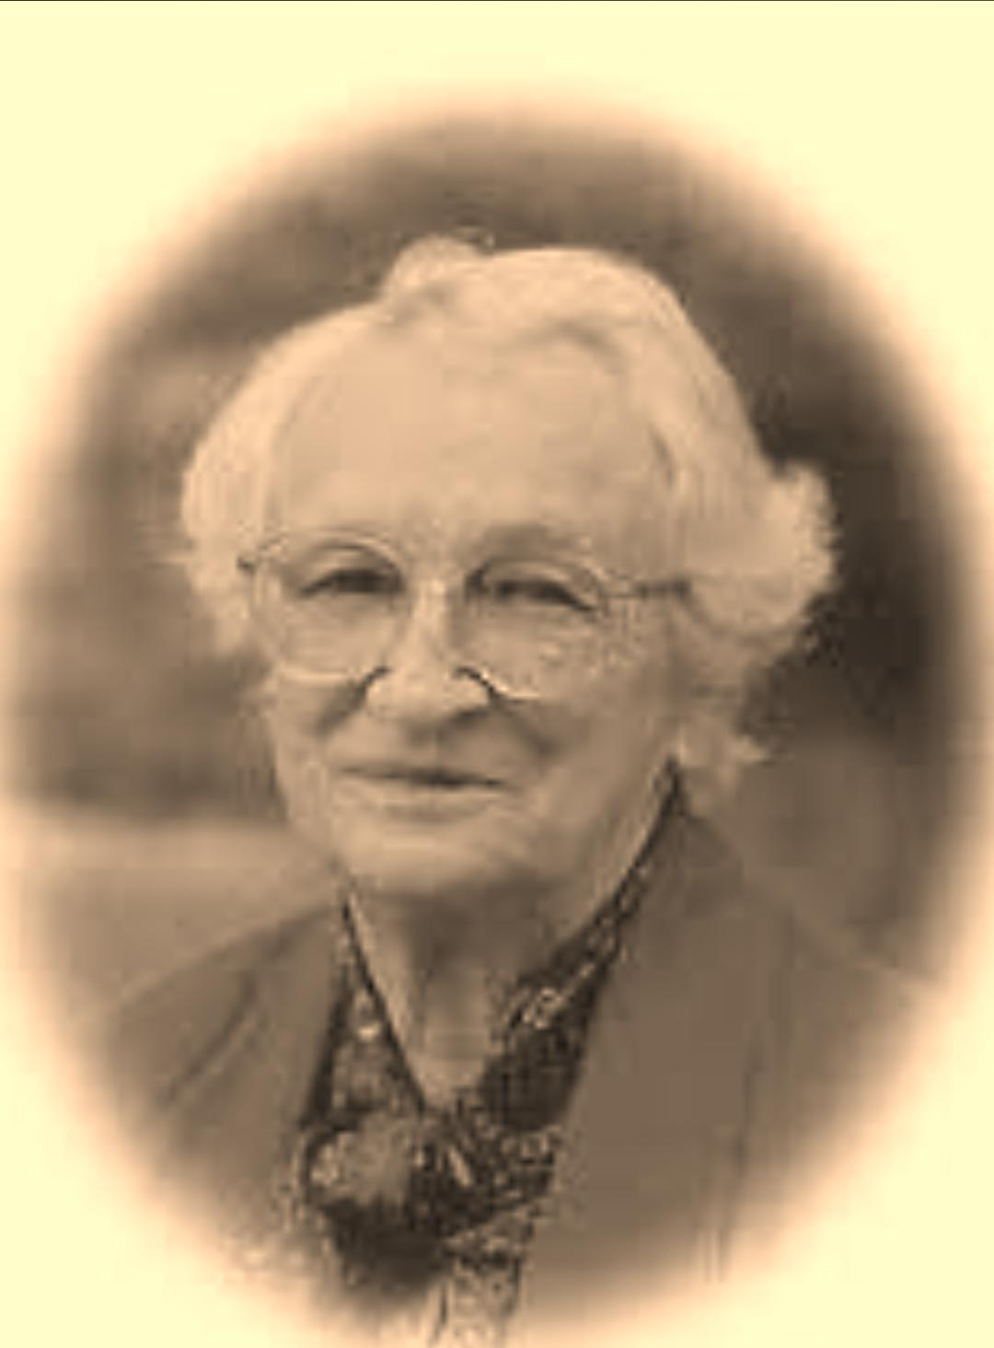
In Riehl's model, interacting with the patient requires advanced skills
for nurses, as empathy and non-verbal communication must be
interpreted very well and nursing diagnoses and interventions must
be applied accordingly. Communication should not be handled only
verbally. With Riehl's model, nursing diagnoses and interventions
can be implemented by using symbols with patients who cannot
communicate verbally. In the model, symbols are analyzed with the FANCAP formulation.
The nurse interprets and evaluates the actions, reactions, and
thoughts of the patient. These obtained data are symbols for the
nurse. Problems are identified based on the main headings and
symbols in the below.
•Fluids •Aeration •Nutrition •Communication •Activity •Pain
FANCAP data can be obtained physiologically, environmentally,
sociocultural, and psychologically. In the model, it was aimed that
nurses provide as comprehensive care as possible.

Slide 3
Interventions: The patient's vital signs, I&O checked . Peripheral edema findings in regions such as neck
veins, tibia, ankle, back, and sacrum were evaluated. The edematous
region has been upgraded. Fluid restriction,
diuretic therapy was performed. Before and after dialysis, the patient's edema, fluid, and electrolyte levels were evaluated .
Interventions: The patient's vital signs, I&O
recorded. Edema control was performed in terms of peripheral edema. Fluid restriction was done.
Edema and fluid electrolyte values were monitored before and after dialysis. Antidiuretic treatment ordered according to the physician's
request was applied.
Excess fluid Volume
Risk for electolyte imbalance
Evaluation: There was no increase in edema over the tibia. It was
observed that there was a decrease in the electrolyte values of the
patient on the 7th day. (Sodium: 138 mmol/L, Potassium: 4.7
mmol/dl, Calcium: 8.4 mmol/L, Chlorine: 102 mmol/L
Evaliation : no increase in edema and amount of urine .
Notes:
https://rashasite.ir

Slide 4
Interventions: The patient's respiratory rate and rhythm were
evaluated and recorded. Tidal volume, Peep, Respiratory Frequency
in patient's vital signs, and mechanical ventilation. FiO2 parameters
were closely monitored. Endotracheal tube and oral suctioning were
performed . A position was given every 2 hours. Blood gas values were checked. Ordered bronchodilator drugs were administered. Endotracheal tube care and oral care were performed.
Interventions: A nasogastric tube used . Because of nausea, the antiemetic drug used Ordered enteral solutions were given. Gastric residual volume was checked . Liquid electrolyte values were monitored. . Oral care was given to the patient. The oral mucous membrane was evaluated every day.
Ineffective breathing pattern
Imbalanced nutrition: Less than body
requirement
Evaluation: Recorded at SpO2:99-100 levels. In blood gas
monitoring pH:7.396, pO2:96 mmHg, pCO2:36 mmHg, SaO2:97%,
HCO3:24.8 mEq/L
Evaluation: Enteral nutrition was provided according to the daily
calorie requirement of the patient.

Slide 5
Interventions: The patient's non-verbal behavior was observed. The facial and body signs of the patient were evaluated. The patient was informed about all procedures performed. Family relatives were allowed to meet with the patient during visiting hours.
BS checked. He was followed closely in terms of hyperglycemia and hypoglycemia. The diabetic formula was used in enteral feeding.
Impaired verbal communication
Risk for unstable blood glucose level
Evaluation: It was observed that the patient was compliant with the
procedures performed.
Evaluation: The patient's blood sugar follow-ups were recorded at
120-200 mg/dL levels.

Slide 6
Interventions: The presence of skin dryness, rash, ecchymosis, and edema was evaluated daily. The amount of fluid ingested and expelled was tracked and recorded. Pressure zones were assessed faily. Body care is done. The body is hydrated. Bed linens were kept clean, dry, and wrinkle-free. A position was given every 2 hours.
Interventions: Hemoglobin, hematocrit, INR, and PT/aPTT values of the patient were checked against the risk of bleeding due to heparin administration in hemodialysis and anticoagulant in treatment. The fistula site and catheters were observed for bleeding. Anticoagulants in her treatment were applied according to the physician's request.
Impaired skin integrity
Risk for bleeding
Evaluation: No increase in edema on the tibia was observed. Redness over the sacrum did not progress
Evaluation: No bleeding was observed in the patient.

Slide 7
Interventions: The symptoms, signs, and reactions of the patient for pain during invasive procedures, endotracheal tube suctioning, oral and body care, and position changes were observed and evaluated. Pain was assessed using a non-verbal pain scale and appropriate analgesics were administered when necessary. The patient was given
a suitable position.
Acute Pain
Evaluation: It was observed that she responded less to the
interventions

