Slide 1
In the name of god
Master:Dr.Raesi
Presenter:
yasaman sadat salehi

Slide 2
Coronary artery diseases
S.A
CAD
U.S.A
NSTEMI
ACS
STEMI

Slide 3
Cardiac Biomarkers
Cardiac troponin
the highest sensitivity
troponin T and troponin I
Troponin I is highly specific to the heart and stays higher longer than creatinine kinase-MB.
Creatinine kinase
CK-MB
Myoglobin

Slide 4
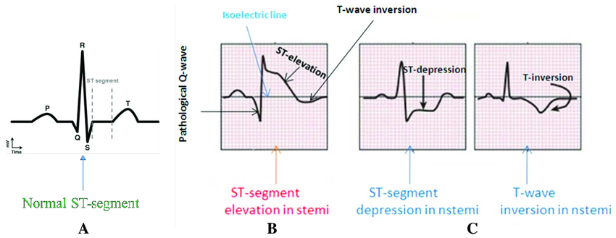
THE HUMAN CIRCULATORY SYSTEM
Function
Main Parts
To transport blood, oxygen and nutrients to the body
Has three main parts: the heart, blood vessels and blood

Slide 5
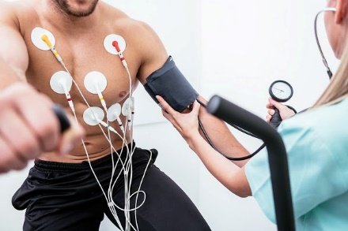
THE HEART

Slide 6
Healthcare providers assess your response to the increased workload by measuring:
Blood pressure.
Heart rate.
Oxygen levels.
Electrical activity in your heart.
How hard your heart is working compared with others your age and sex.
CHECK: THE
How does a stress test work?
A heart stress test starts by making your heart pump harder and faster. For many people, this includes walking on a treadmill or riding a stationary bicycle. That’s why the test is often called an exercise stress test.

Slide 7
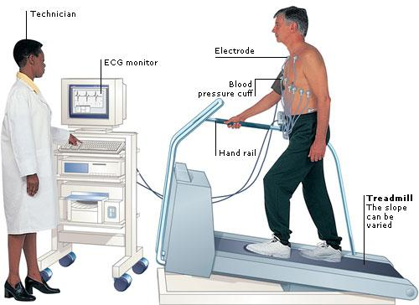
B
C
for blur
for confetti
D
M
for mic drop
for a drumroll
O
O
for bubbles
for quiet

Slide 8
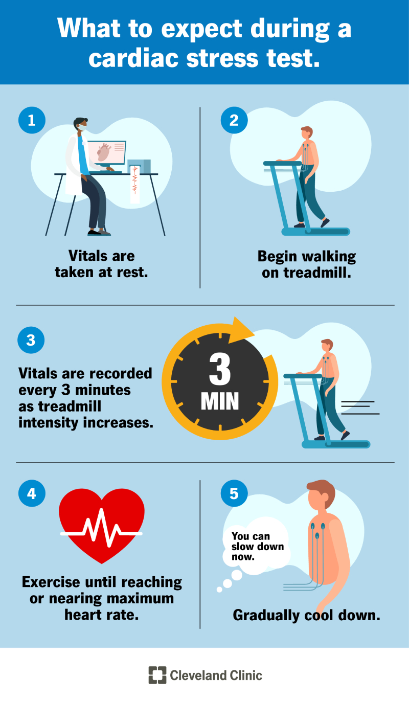
What happens during an exercise stress test? CHECK: THE HEART
Right Atrium
Left Atrium
body
lungs
Right Ventricle
Left Ventricle
lungs
body

Slide 9
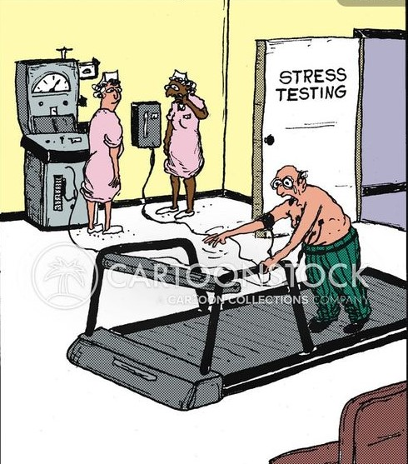
Not eat anything in the hours leading up to the test.
Avoid caffeine for 24 hours before testing. This includes coffee, tea, energy drinks and certain over-the-counter medications.
Not smoke or use tobacco products.
Stop taking certain prescription medications the day of your test. These include beta-blockers and asthma inhalers.
Talk to your healthcare provider before stopping any medications.
Try to relax.
It’s natural to be nervous about heart testing, but feeling anxious can affect your results.
Wear lightweight, comfortable clothes and sturdy walking shoes.
How do I prepare for an exercise stress test?
.

Slide 10
THE HEART
Why might I need a stress test?
You may need this test to detect heart problems like:
Congenital heart disease.
Congestive heart failure.
Coronary artery disease.
Heart valve disease.
Hypertrophic cardiomyopathy.
People with high-risk occupations (like pilots or professional athletes) may also need stress tests.
from left lung

Slide 11
What are the risks associated with exercise testing?
abnormal blood pressure
chest pain
shortness of breath
fainting
disorders of the heart beat
(too rapid, too slow or unusual beats)
heart attack.

Slide 12
THE HEART
Thanks

