Slide 1
In the name of god
Master:Dr.Raesi Presenter: mobin ghaderi

Slide 2
Situs classification
body situs can be a daunting topic, but it falls into three main groups:
situs solitus
situs inversus
situs ambiguus

Slide 3
01
situs solitus
the normal position of the thoracic and abdominal organs. This will include a left-sided heart, also known as levocardia.
Notes:
The aortic arch, gastric fundus, cardiac apex and splenic shadow should all be left-sided (a left-positioned heart is known as levocardia). The bronchi branching pattern should not be symmetrical; the right main bronchus should be shorter and more vertically oriented than the left main bronchus. The minor fissure should be only visible on the right side. The liver shadow should be right-sided.

Slide 4
situs inversus
02
is a term used to describe the inverted position of chest and abdominal organs.

Slide 5
situs inversus
02

Slide 6
Dextrocardia

Slide 7
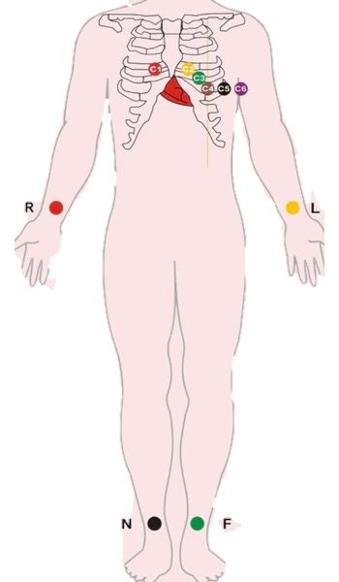
ECG

Slide 8
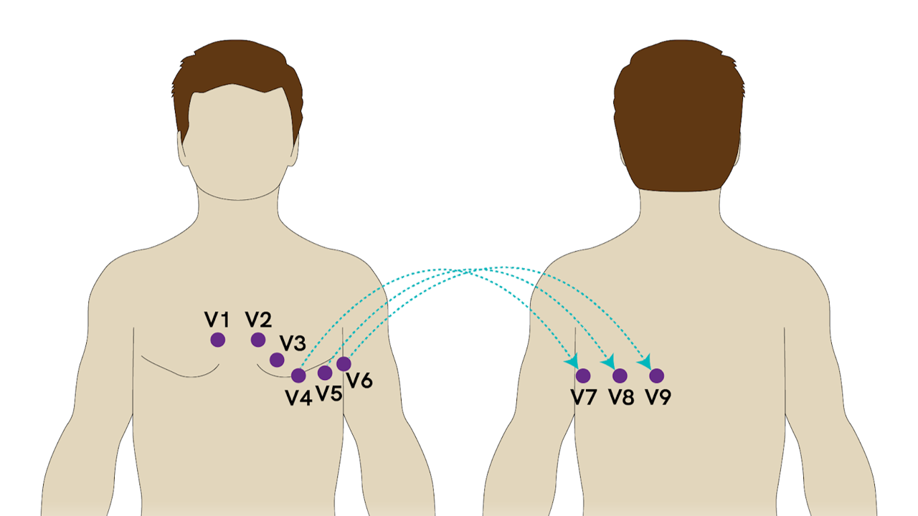
ECG

Slide 9
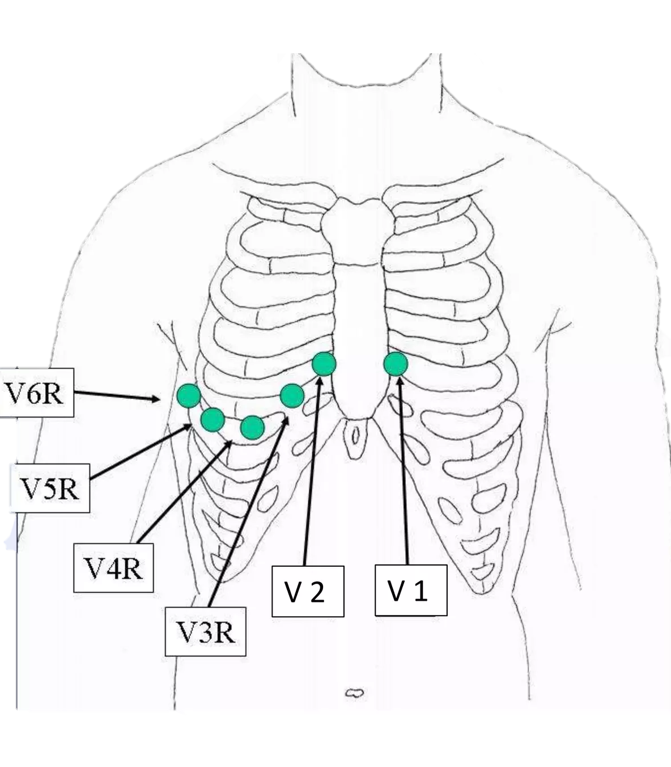
ECG

Slide 12
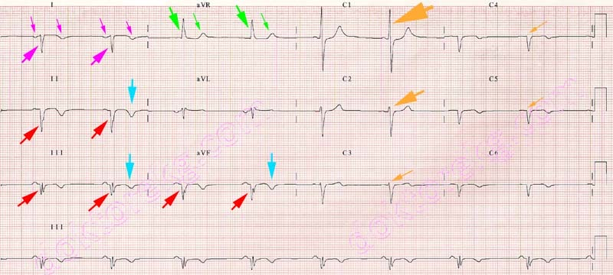

Slide 13
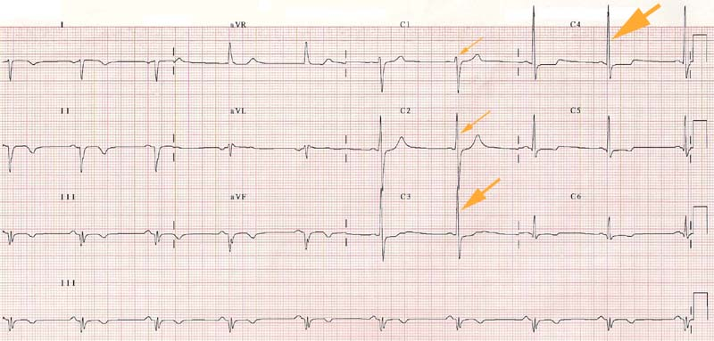

Slide 14
Thanks

