Slide 1
SYSTEMIC SCLEROSIS
A rare, progressive, immune-mediated disease professor: Ghaderi presenter: Mahdiye miri

Slide 2
SYSTEMIC SCLEROSIS
A rare, progressive, immune-mediated disease
Reported incidence between
56 cases per
million
Reported prevalence of
2 individuals
per 10,000
Strong sex bias with a ratio of
3:1 more women than men
affected
Mortality rate
is greater than in
any other rheumatic disease

Slide 3
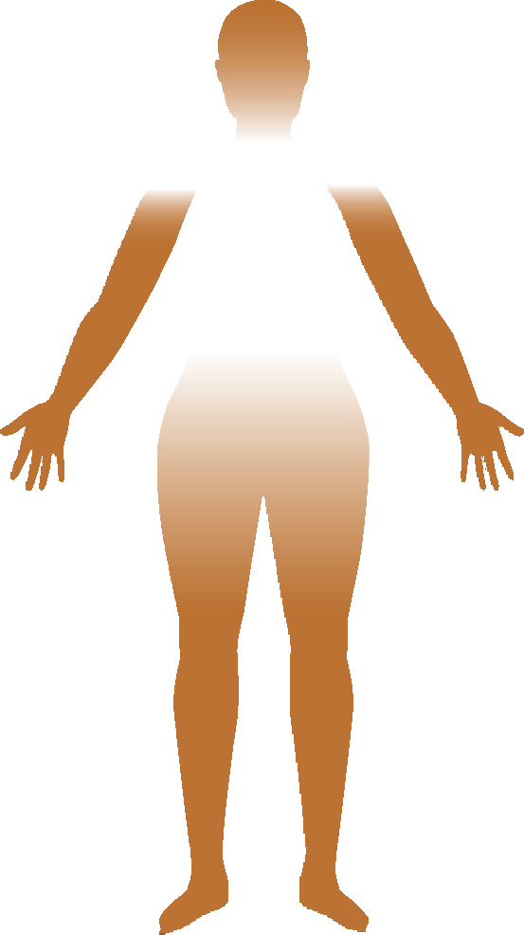
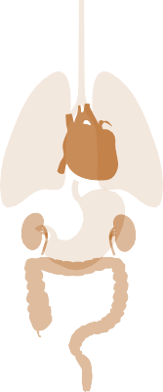
SYSTEMIC SCLEROSIS CLINICAL SUBTYPES
A rare, progressive, immune-mediated disease
Without skin involvement (<5% patients)
With skin involvement (≥95% patients)
SYSTEMIC SCLEROSIS SINE SCLERODERMA
LIMITED CUTANEOUS SYSTEMIC SCLEROSIS
DIFFUSYSTEMICSE CUTANEOUS SCLEROSIS
SYSTEMIC SCLEROSIS OVERLAP SYNDROME
Manifestations of 1 of the 3 subtypes, with clinical and investigational features of another rheumatic disease

Slide 4
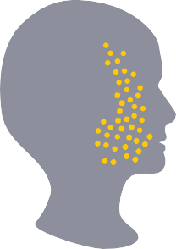
LIMITED CUTANEOUS SYSTEMIC SCLEROSIS
A subtype with restricted skin but major internal organ involvement

Slide 5
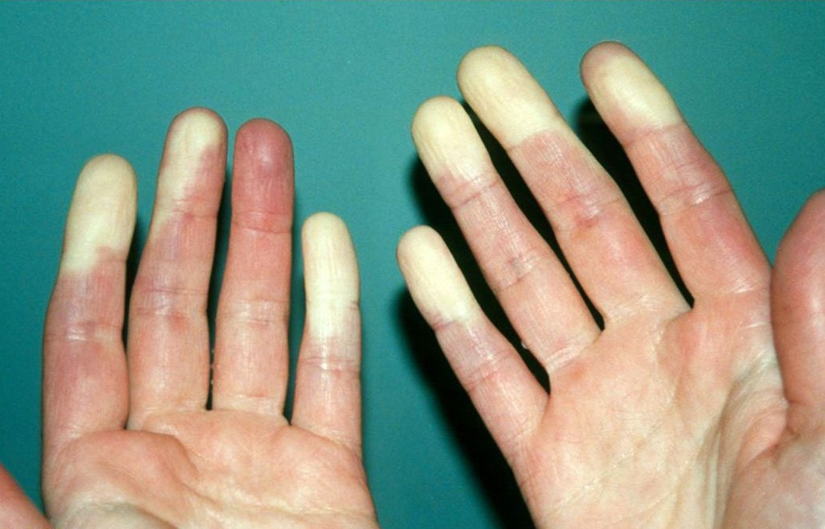
LIMITED CUTANEOUS SYSTEMIC SCLEROSIS
A subtype with restricted skin but major internal organ involvement
Clinical presentation
Typically there is long history of Raynaud’s phenomenon.

Slide 6
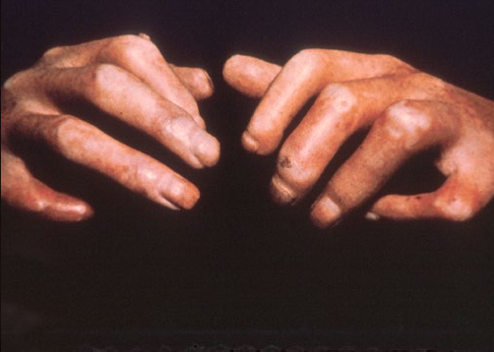
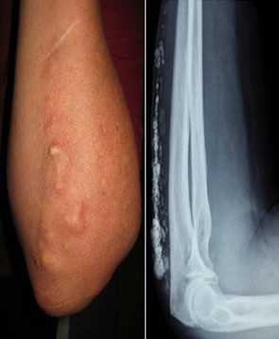
LIMITED CUTANEOUS SYSTEMIC SCLEROSIS
A subtype with restricted skin but major internal organ involvement
Clinical presentation
Sclerodactyly occurs late and is limited to fingers and toes. Extensive calcinosis cutis may occur.

Slide 7
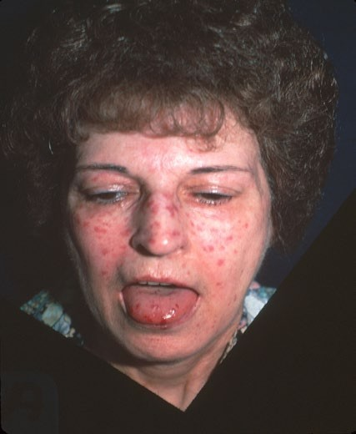
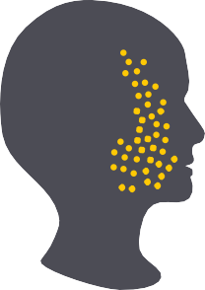
LIMITED CUTANEOUS SYSTEMIC SCLEROSIS
A subtype with restricted skin but major internal organ involvement
Clinical presentation
Facial and mucosal membrane telangiectasias are a common clinical presentation.
.

Slide 8
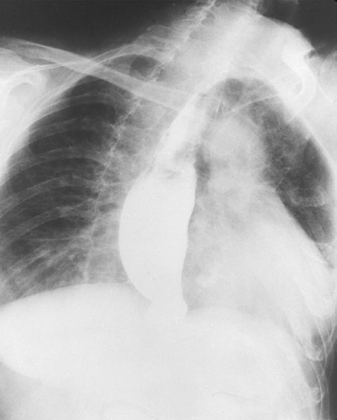
LIMITED CUTANEOUS SYSTEMIC SCLEROSIS
A subtype with restricted skin but major internal organ involvement
Clinical presentation
Esophageal dysmotility, which results in gastroesophageal reflux, is a frequent gastrointestinal feature.
Denton CP, Khanna D. Lancet. 2017. doi:10.1016/S0140-6736(17)30933-9. Pattanaik D, et al. Front Immunol. 2015;6:272. doi:10.3389/fimmu.2015.00272.

Slide 9
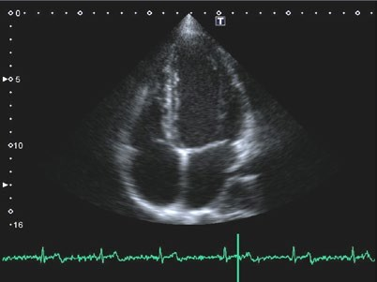
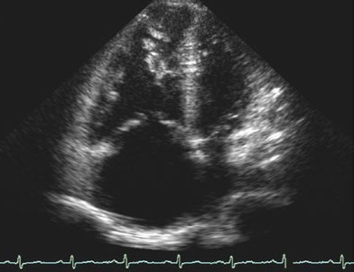
LIMITED CUTANEOUS SYSTEMIC SCLEROSIS
A subtype with restricted skin but major internal organ involvement
Clinical presentation
Normal
PAH
Images courtesy of Dr Luke Howard, DPhil, FRCP.
Severe pulmonary arterial hypertension (PAH) is frequent.

Slide 10
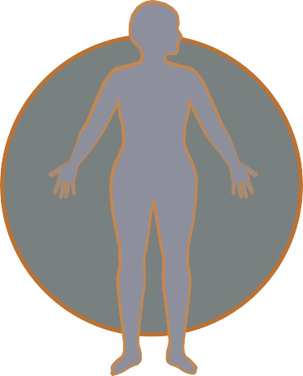
DIFFUSE CUTANEOUS SYSTEMIC SCLEROSIS
A subtype with extensive internal organ and skin involvement

Slide 11
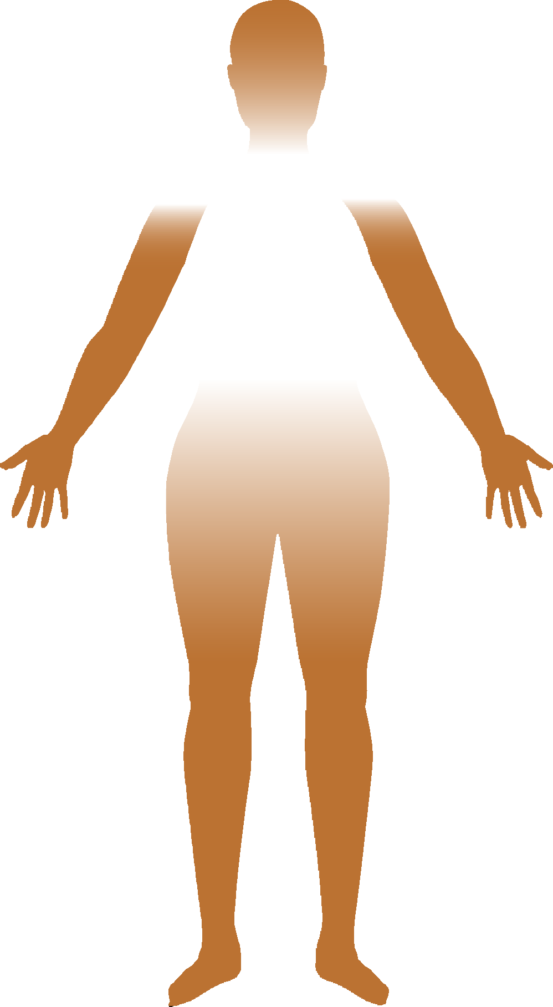
DIFFUSE CUTANEOUS SYSTEMIC SCLEROSIS
A subtype with extensive internal organ and skin involvement
Clinical presentation
Typically there is a short history of Raynaud’s phenomenon.
.

Slide 12
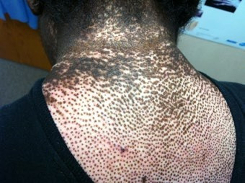
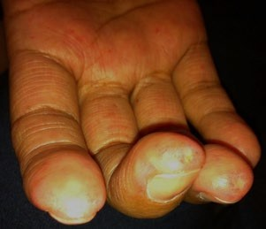
DIFFUSE CUTANEOUS SYSTEMIC SCLEROSIS
Clinical presentation
Salt-and-pepper skin discoloration Digital ulcers
Early distal skin thickening can progress to involve proximal extremities as well as the trunk.
Peak skin involvement occurs at 12–18 months
Skin thickness may decrease late in the disease
•
Digital ulcers may be present.

Slide 13
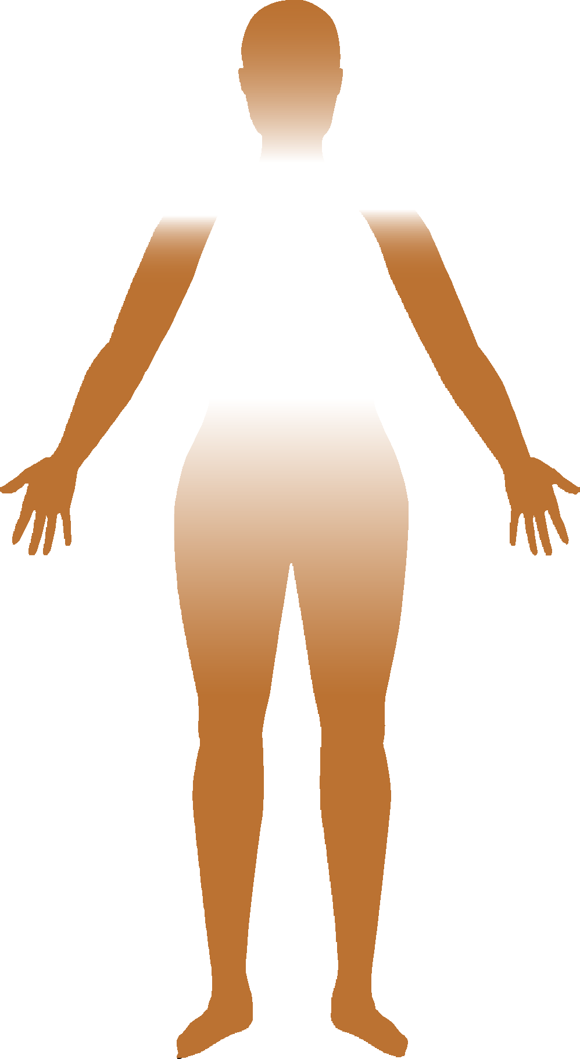
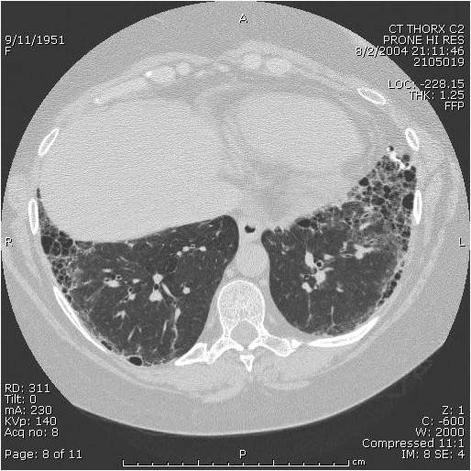
DIFFUSE CUTANEOUS SYSTEMIC SCLEROSIS
Clinical presentation
FPO
25%–30% of patients develop progressive interstitial lung disease.
.

Slide 14
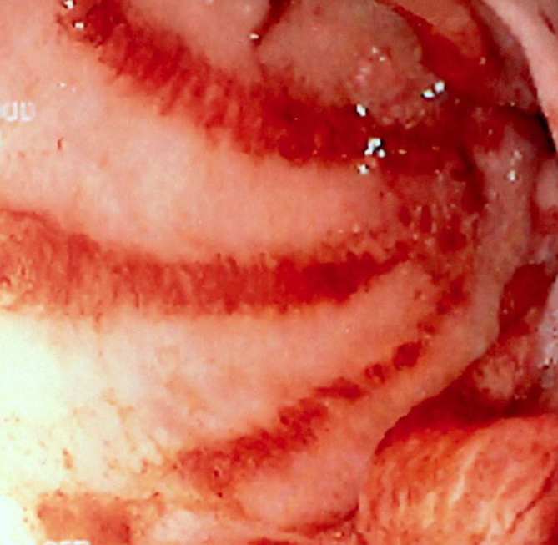
DIFFUSE CUTANEOUS SYSTEMIC SCLEROSIS
Clinical presentation
Early gastric antral vascular ectasia (watermelon stomach) may occur.
.

Slide 15
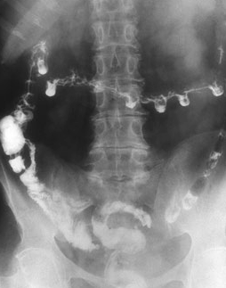
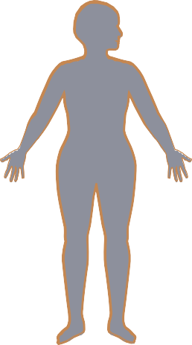
DIFFUSE CUTANEOUS SYSTEMIC SCLEROSIS
Clinical presentation
Gastrointestinal complications in the small and large intestine, including blind loop syndrome (small intestinal bacterial overgrowth), malabsorption syndrome, and intestinal pseudo-obstruction,
are common.

Slide 16
SYSTEMIC SCLEROSIS
A rare, progressive, immune-mediated disease
NOT JUST SKIN DEEP

