Slide 1
-
In the name of God
Maggot therapy
Provider: Abolfazl Khanverdi
Supervisor: Mr Ghaderi

Slide 2
Types of Debridement
Surgery
Autolytic
Mechanical
Enzymatic
Sharp
Biological

Slide 3
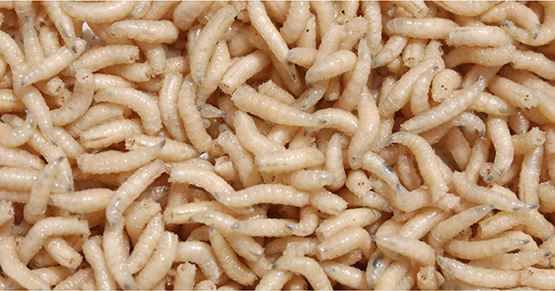
Biological

Slide 4
Mechanism of action
Swallowing dead tissue
Releasing degradative enzymes
Stimulation of healing
Disinfection

Slide 5
Indication
Contraindications
Chronic Wounds
Pressure Sores
Infected Wounds
Diabetic Foot Ulcers
Predecessors
Cancerous wounds
Actively bleeding wounds
Exuding wounds
Necrotic wounds
Tunnel wounds
2024

Slide 6
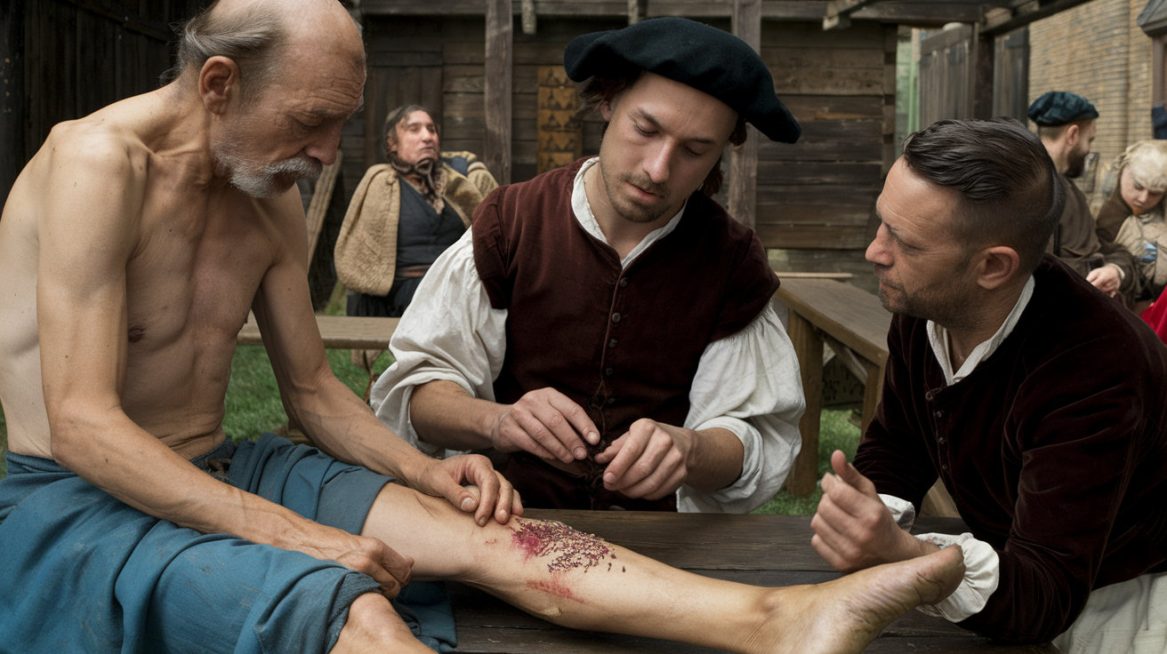
History

Slide 7
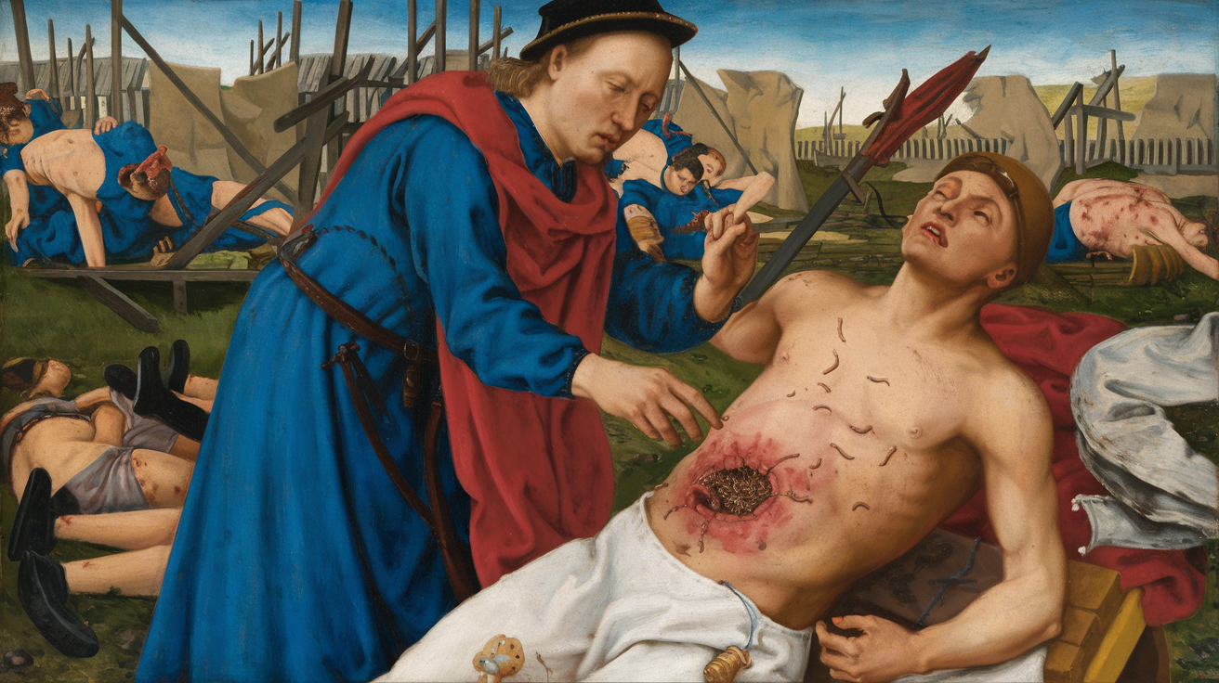
History

Slide 8
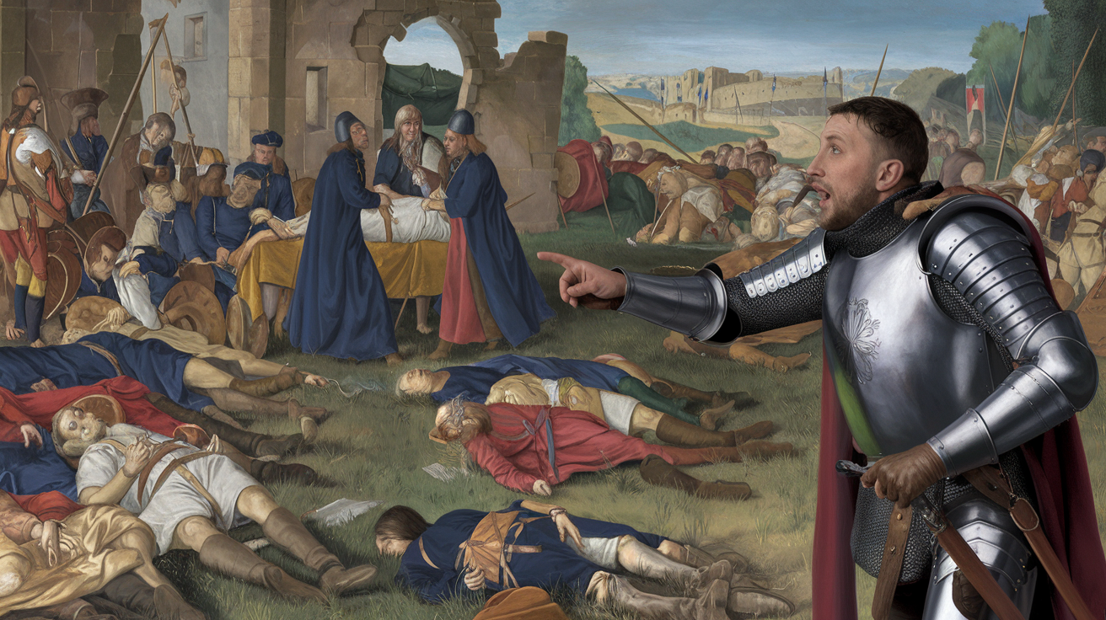
History

Slide 9
Every great advance in science has been the result of the courage to imagine something new!
“John Dewey”
Thank You

