Slide 1
وه ناوی وای ژور
Atresia and tracheoesophageal fistula
Persent : Hosein Merati
Master: Mohammed Sajjad ghaderi

Slide 2
Introduction
It is a type of congenital malformation in the digestive system, in which the esophagus is underdeveloped in the embryonic period and the connection between the esophagus and the stomach is blocked in the middle of the way, and it is placed behind the trachea like a hanging balloon.

Slide 3
Types of esophageal atresia
The esophagus is split halfway down to the stomach.
The esophagus only shows itself as a bag with a closed bottom and does not have a separated part at the bottom.
Esophagus and trachea are connected by a muscular tube and create an appearance like the letter H.

Slide 4
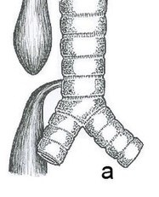
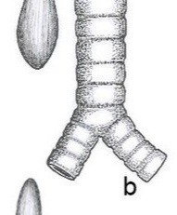
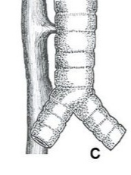

Slide 5
Tracheoesophageal fistula
During the embryonic period, the trachea and esophagus originate from a common tube, which later separates during the fourth fetal week. Error in this separation can lead to the formation of fistula and also esophageal atresia.

Slide 6
Clinical protests
Watery mouth
Suffocation
Respiratory distress
Inability to feed

Slide 7
diagnosis
Diagnosis of polyhydramnios in pregnancy ultrasound
Nasogastric tube
Radiography
Endoscopy
Bronchoscopy

Slide 8
Treatment policy
Surgical measures
Prophylactic measures to prevent the occurrence of Barrett’s esophagus
Providing adequate nutrition.

Slide 9
Nursing interventions
Keep the airway open
Monitor for nerve damage
Wound care and infection control

Slide 10
Case persention

Slide 11
Thank you!

