Slide 1
Acute coronary syndrome due to coronary artery embolism in atrial fibrillation
استاد راهنما:استاد رئیسی
ارائه دهنده:مرجان زمانی

Slide 2
Arterial embolism
Embolus is a piece of fat or clot or air through the bloodstream and can block arteries or veins
Clot usually get stuck in area of atherosclerosis or where arteries branch
The most common arteries include coronary’ mesenteric and cerebral arteries

Slide 3
Arterial embolism
Echocardiography
TEE
ECG
Doppler ultrasound
paresthesia
pallor
paralysis
pain
poikilothermic
pulselessness

Slide 4
Atrial fibrillation
The fastest atrial arrhythmia with a rate of 350 to 600 impulses per minute
Increased risk of thromboembolism
30% reduction in cardiac output

Slide 5
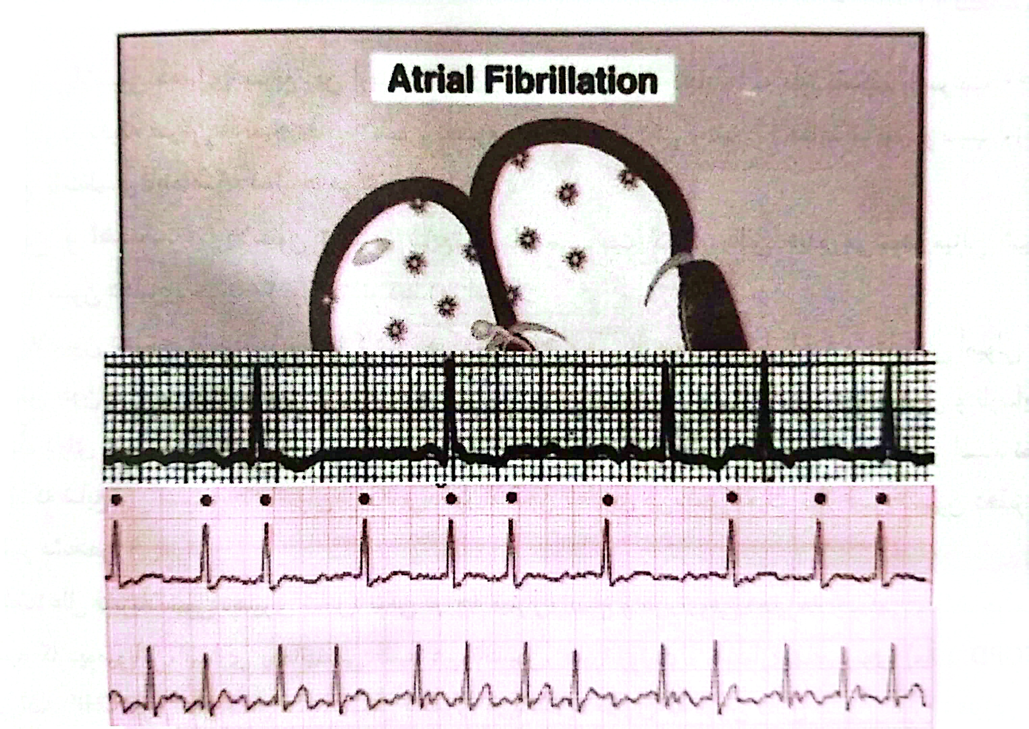
Fine AF course AF

Slide 6
Thank you!

